Slide 1

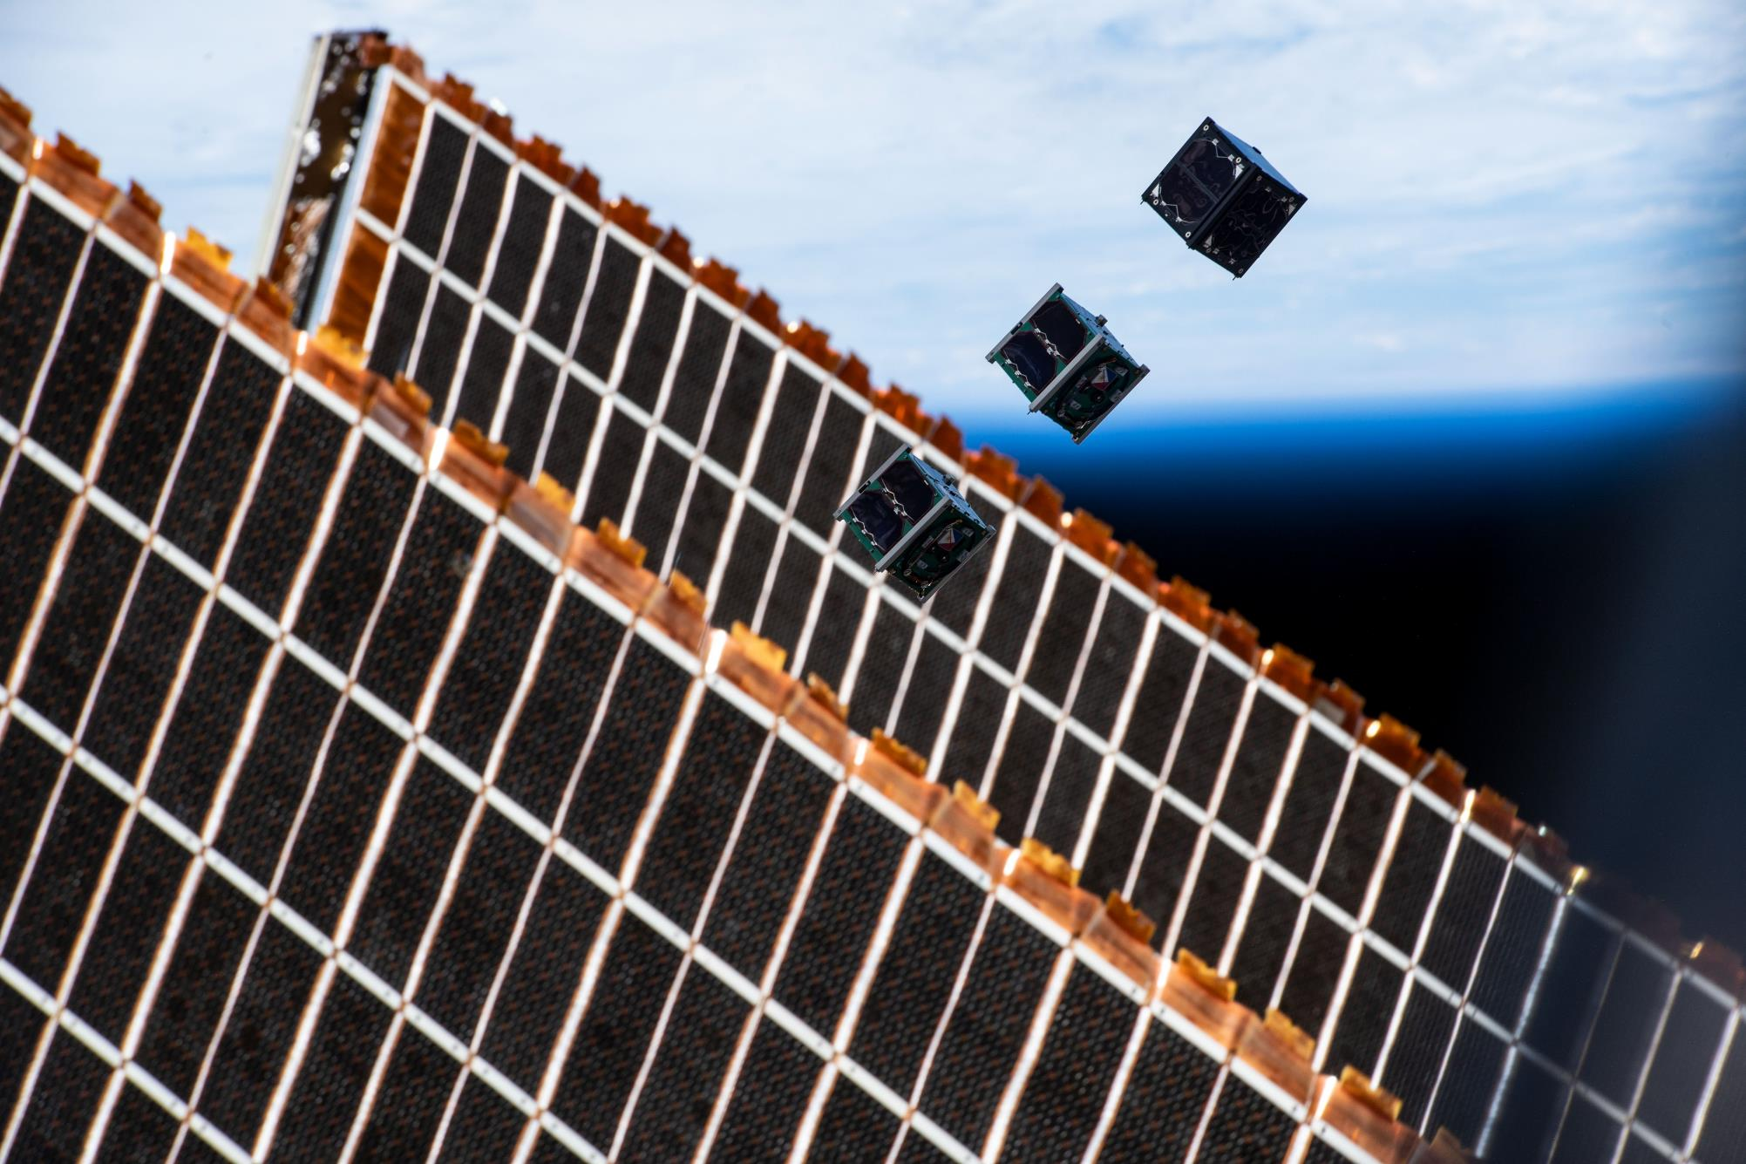
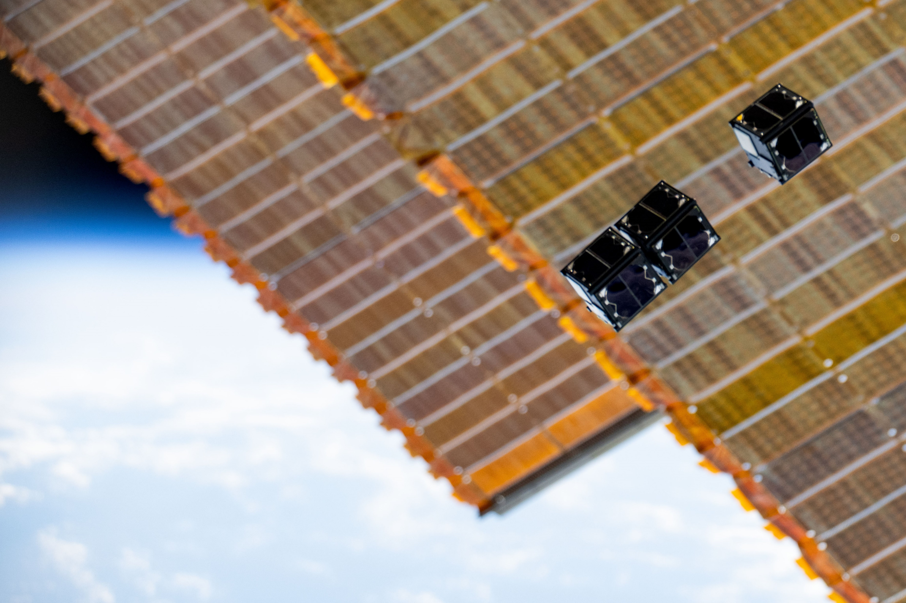

STUDENT GROUND STATION PROJECT Rayaan Atif
Credit: JAXA and NASA

Slide 2

BinarX
BinarX is a program that allows students in Western Australia to design, build, and launch science payloads into space.
The initiative encompasses the Student Payload Development Program.
Engages high-school students in conceptualisation, design, development and launch of space payloads.
Provide hands-on experience in space sciences and engineering
Fosters the next generation of space scientists and engineers

Slide 3
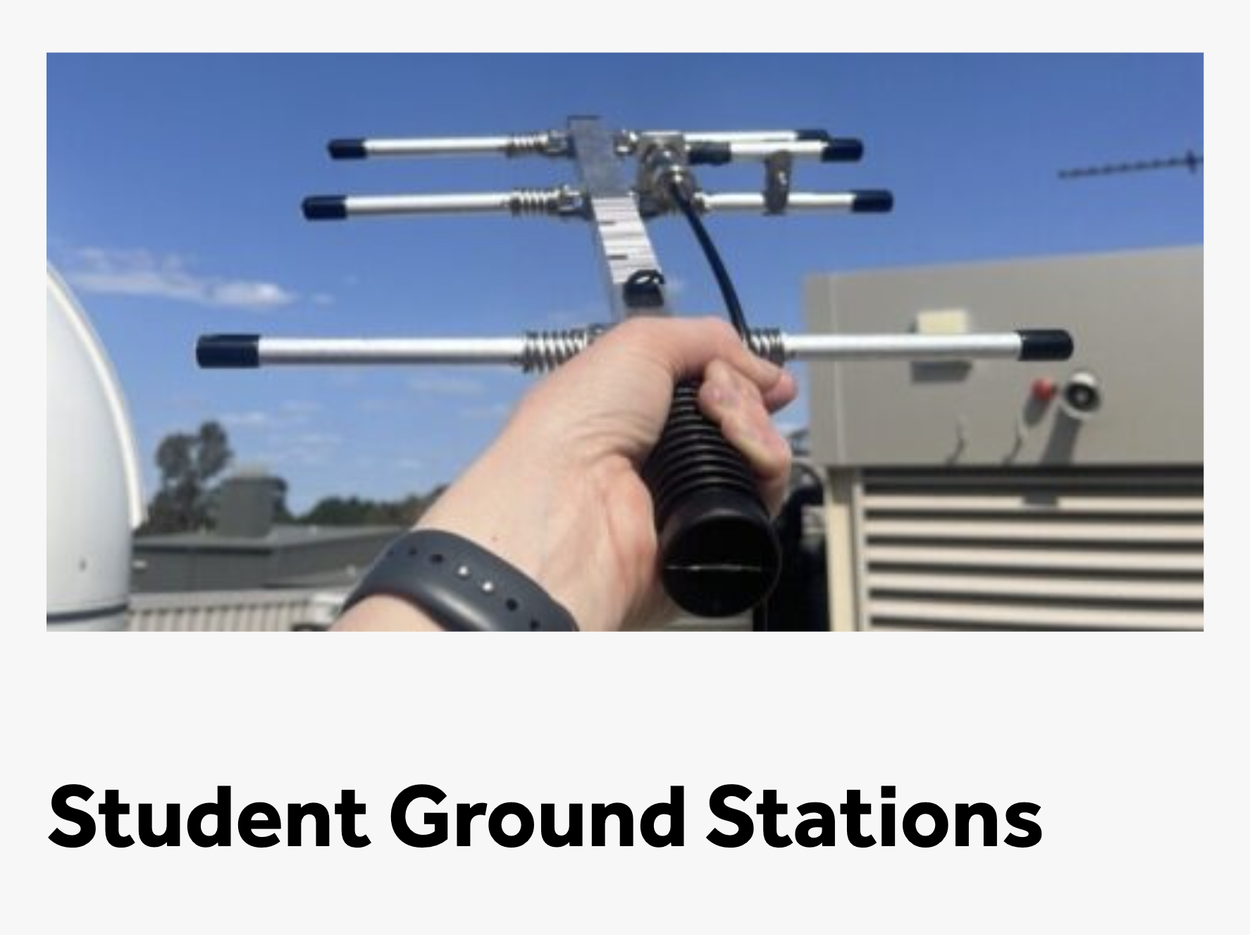
Student Ground Station Kit
The internship focused on developing a satellite ground station kit based on the SatNOGS project.
It enables students and educators to:
establish a communication link with BINAR satellites
receive telemetry data from their payloads when operational.
Facilitates communication with other satellites,
This project aligns with the program's overarching goal, which is to make space science and technology more accessible.

Slide 4

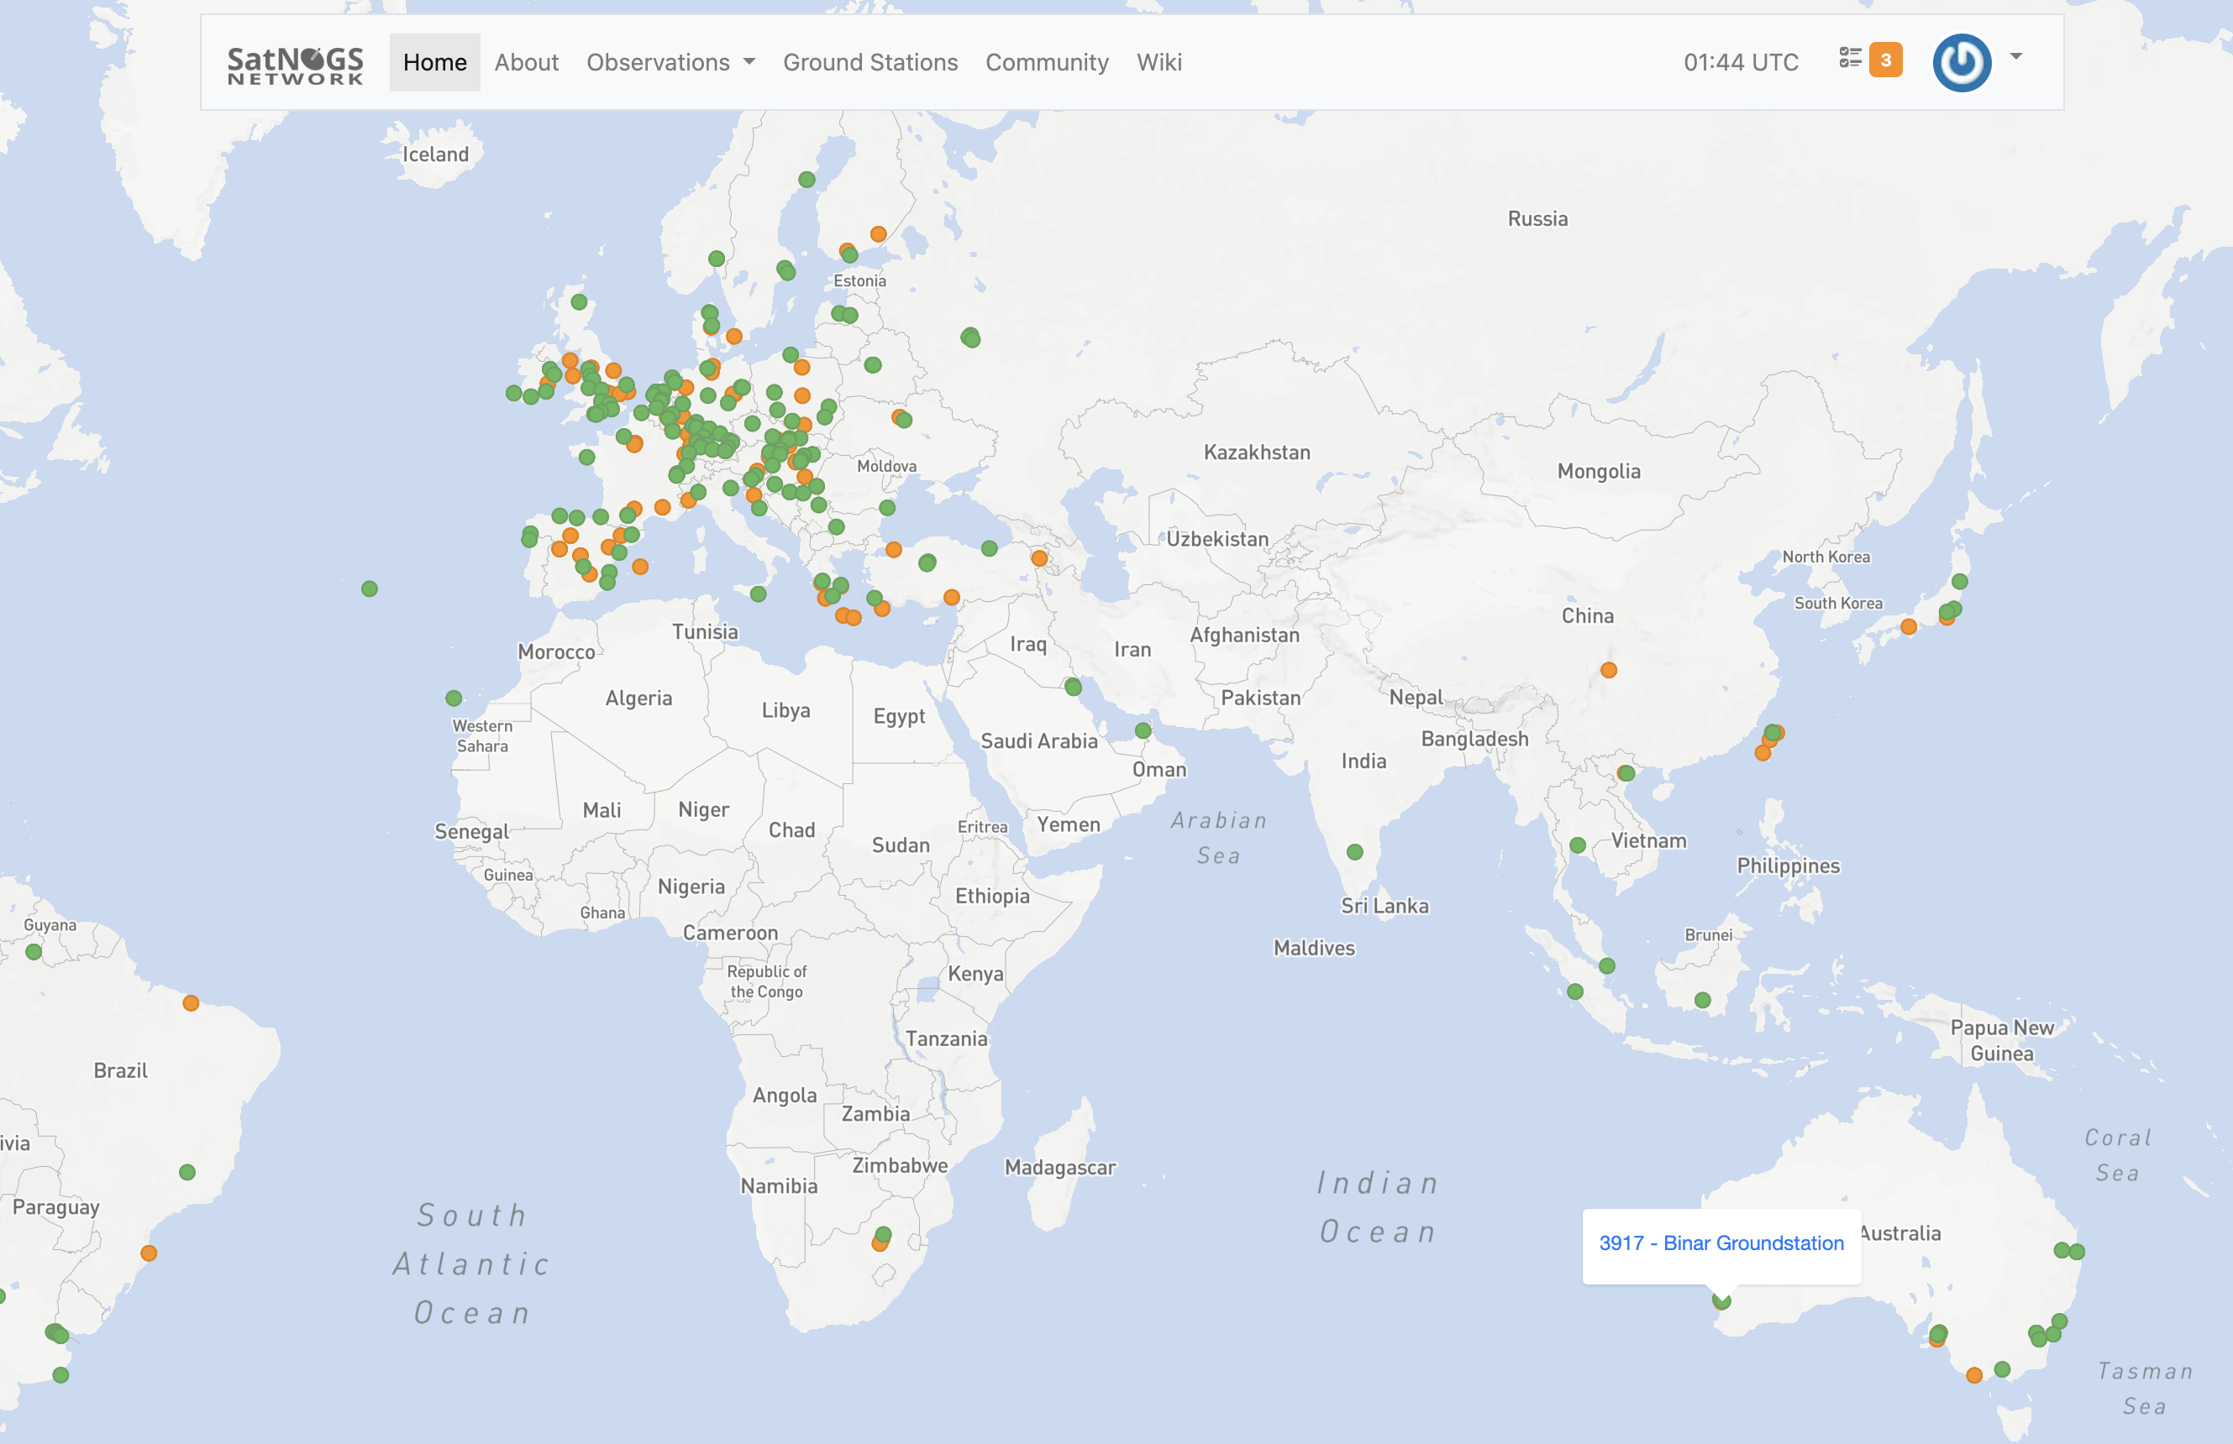
The SatNOGS Project
The SatNOGS Project (Satellite Networked Open Ground Station) is an open-source, global network of satellite ground stations
It is a part of the Libre Space Foundation.
The project is designed around:
Open-Source hardware & software
Global collaboration
Accessible satellite data

Slide 5

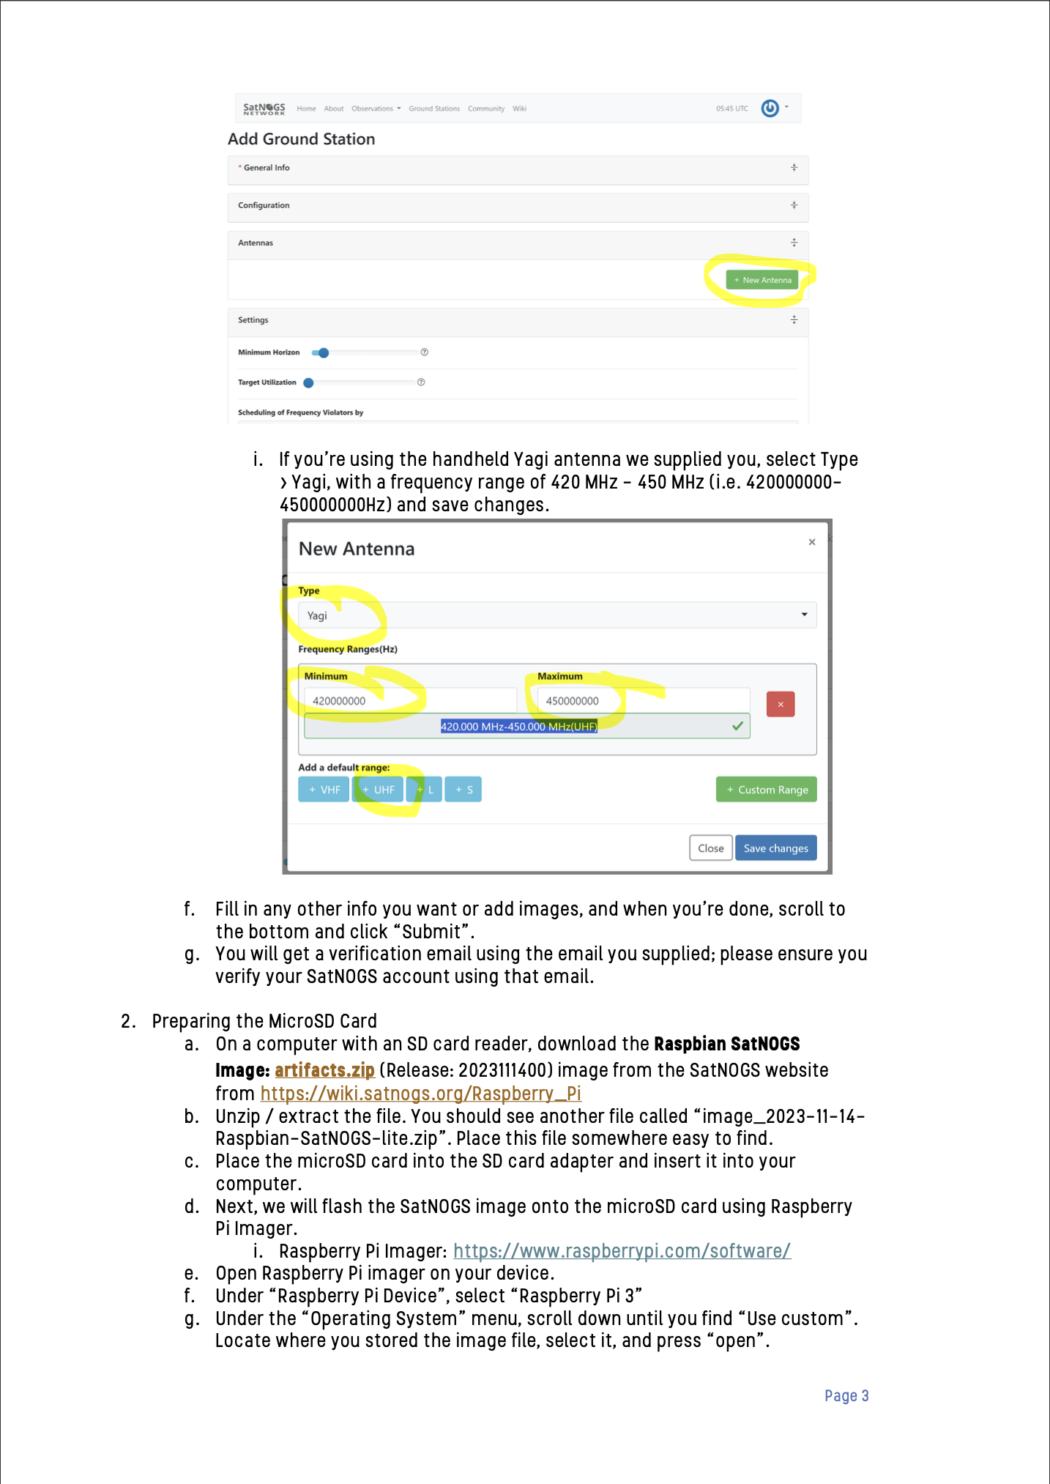


Guide and Outputs
One of the key outputs of the project is a user-friendly guide for students and educators to set up their own ground station.
The guide was based on the framework created by Meg, one of my project supervisors.
It expands on this framework by:
Simplifying or providing further details on the steps improves clarity.
Additional information was supplied to reduce the risk of damaging equipment.
Provides further expansion opportunities to allow students to expand their ground station.

Slide 6


High-Performance Antenna
Another key deliverable of the internship was to design a guide for students to build their own high-performance antenna.
This was the more difficult component of the project, requiring much more knowledge and experience in radio frequency design to create a functioning antenna.
It also required it to be accessible enough for students and educators to make their own.

Slide 7

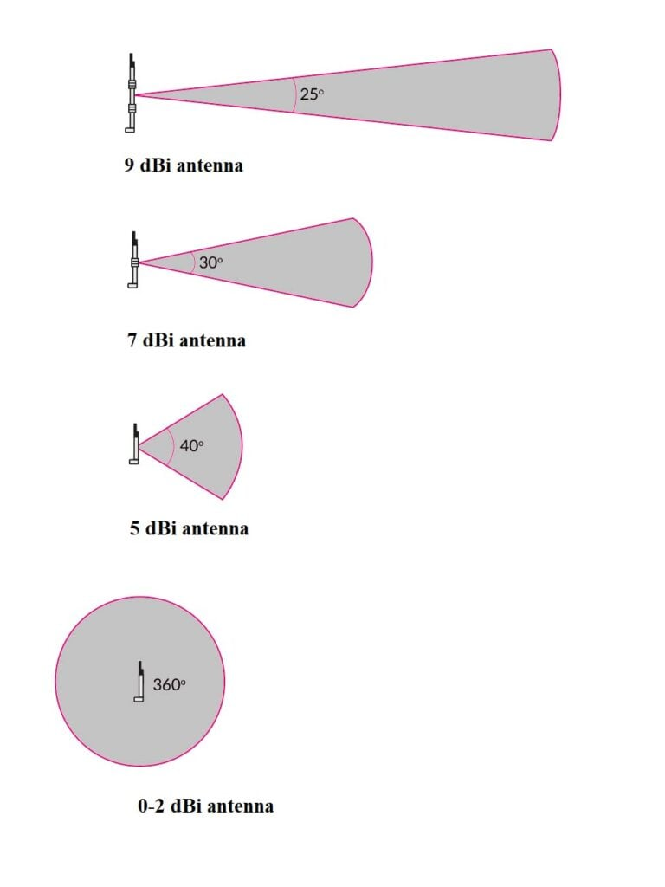
What is a High Performance Antenna?
I decided that for satellite communication, a high-performance antenna refers to one that has low SWR and high gain.
SWR, or standing wave ratio, refers to the proportion of waves reflected from the transceiver through the antenna.
The gain of an antenna is simply the measure of an antenna's ability to direct or concentrate radio frequency energy in a particular direction or pattern. This is much more important.

Slide 8
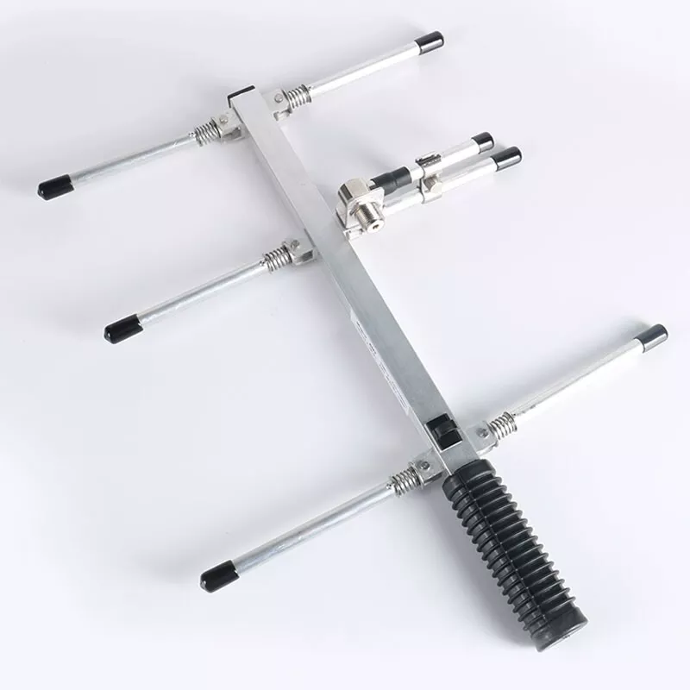
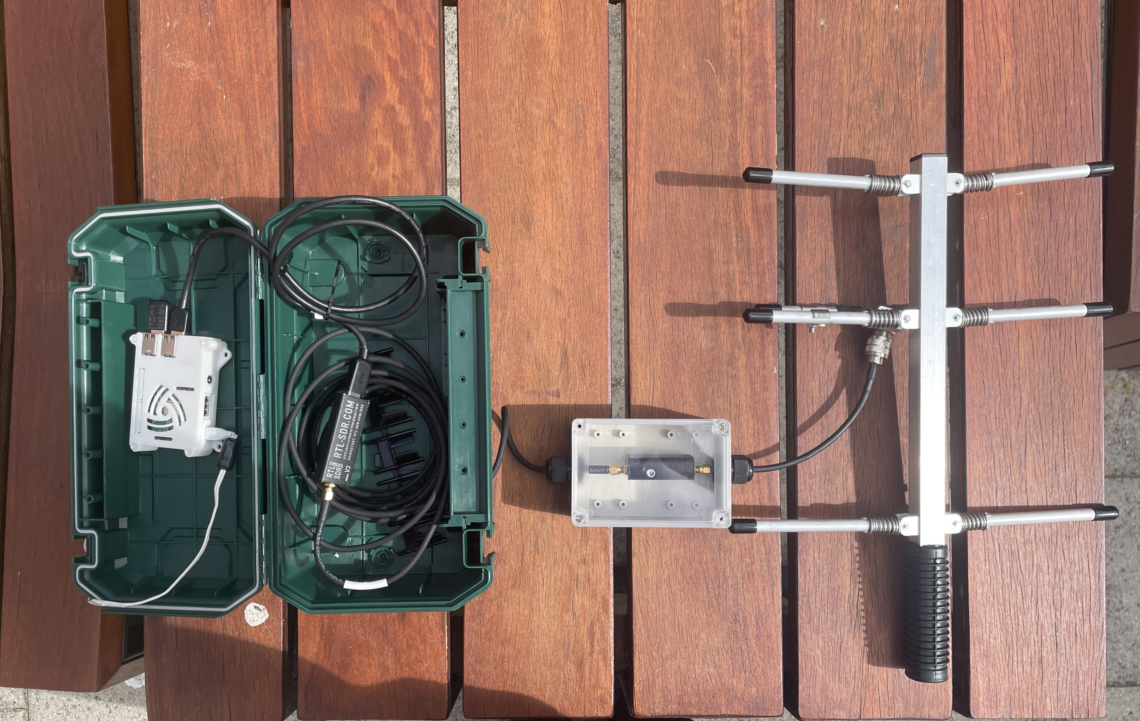
What Currently Exists
The off-the-shelf antenna supplied in the current ground station kit was found to have:
A maximum gain of 6dBi
An SWR, measured when tuned to 436.5 MHz, of 1.2-1.8.
The performance is sufficient to receive stronger satellite signals but struggles to receive telemetry from weaker transmitting satellites.
Thus, a baseline was set to improve on these measurements, aiming to reduce SWR as close to 1:1 and maximise antenna gain through its beam.

Slide 9
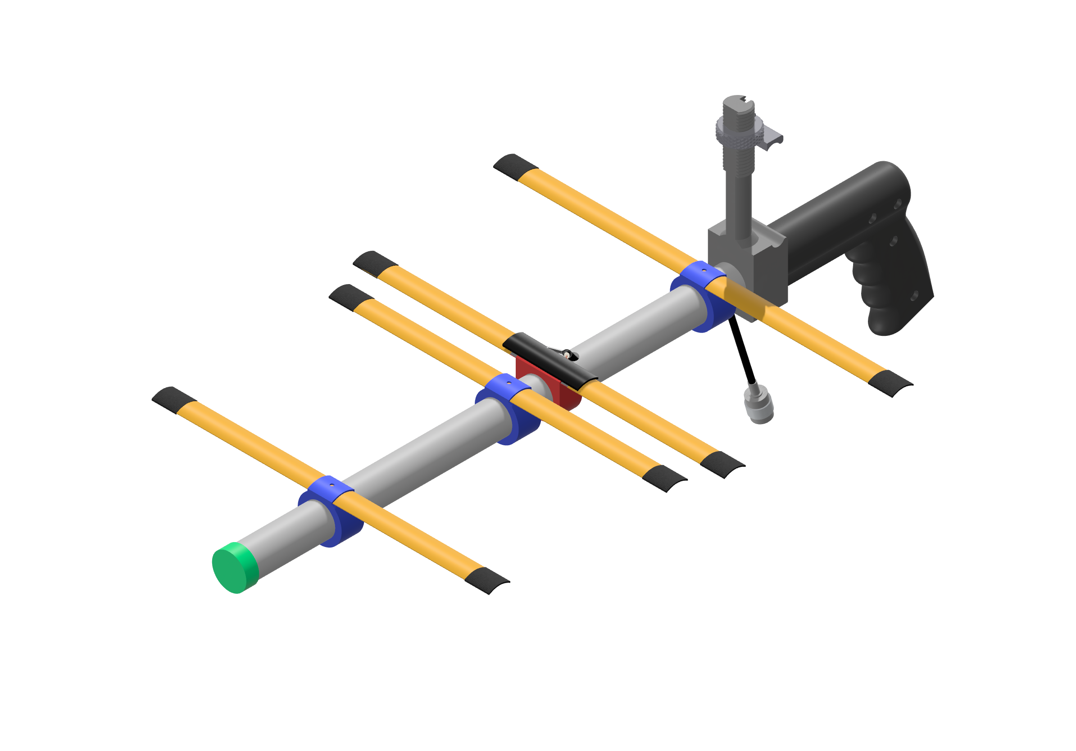
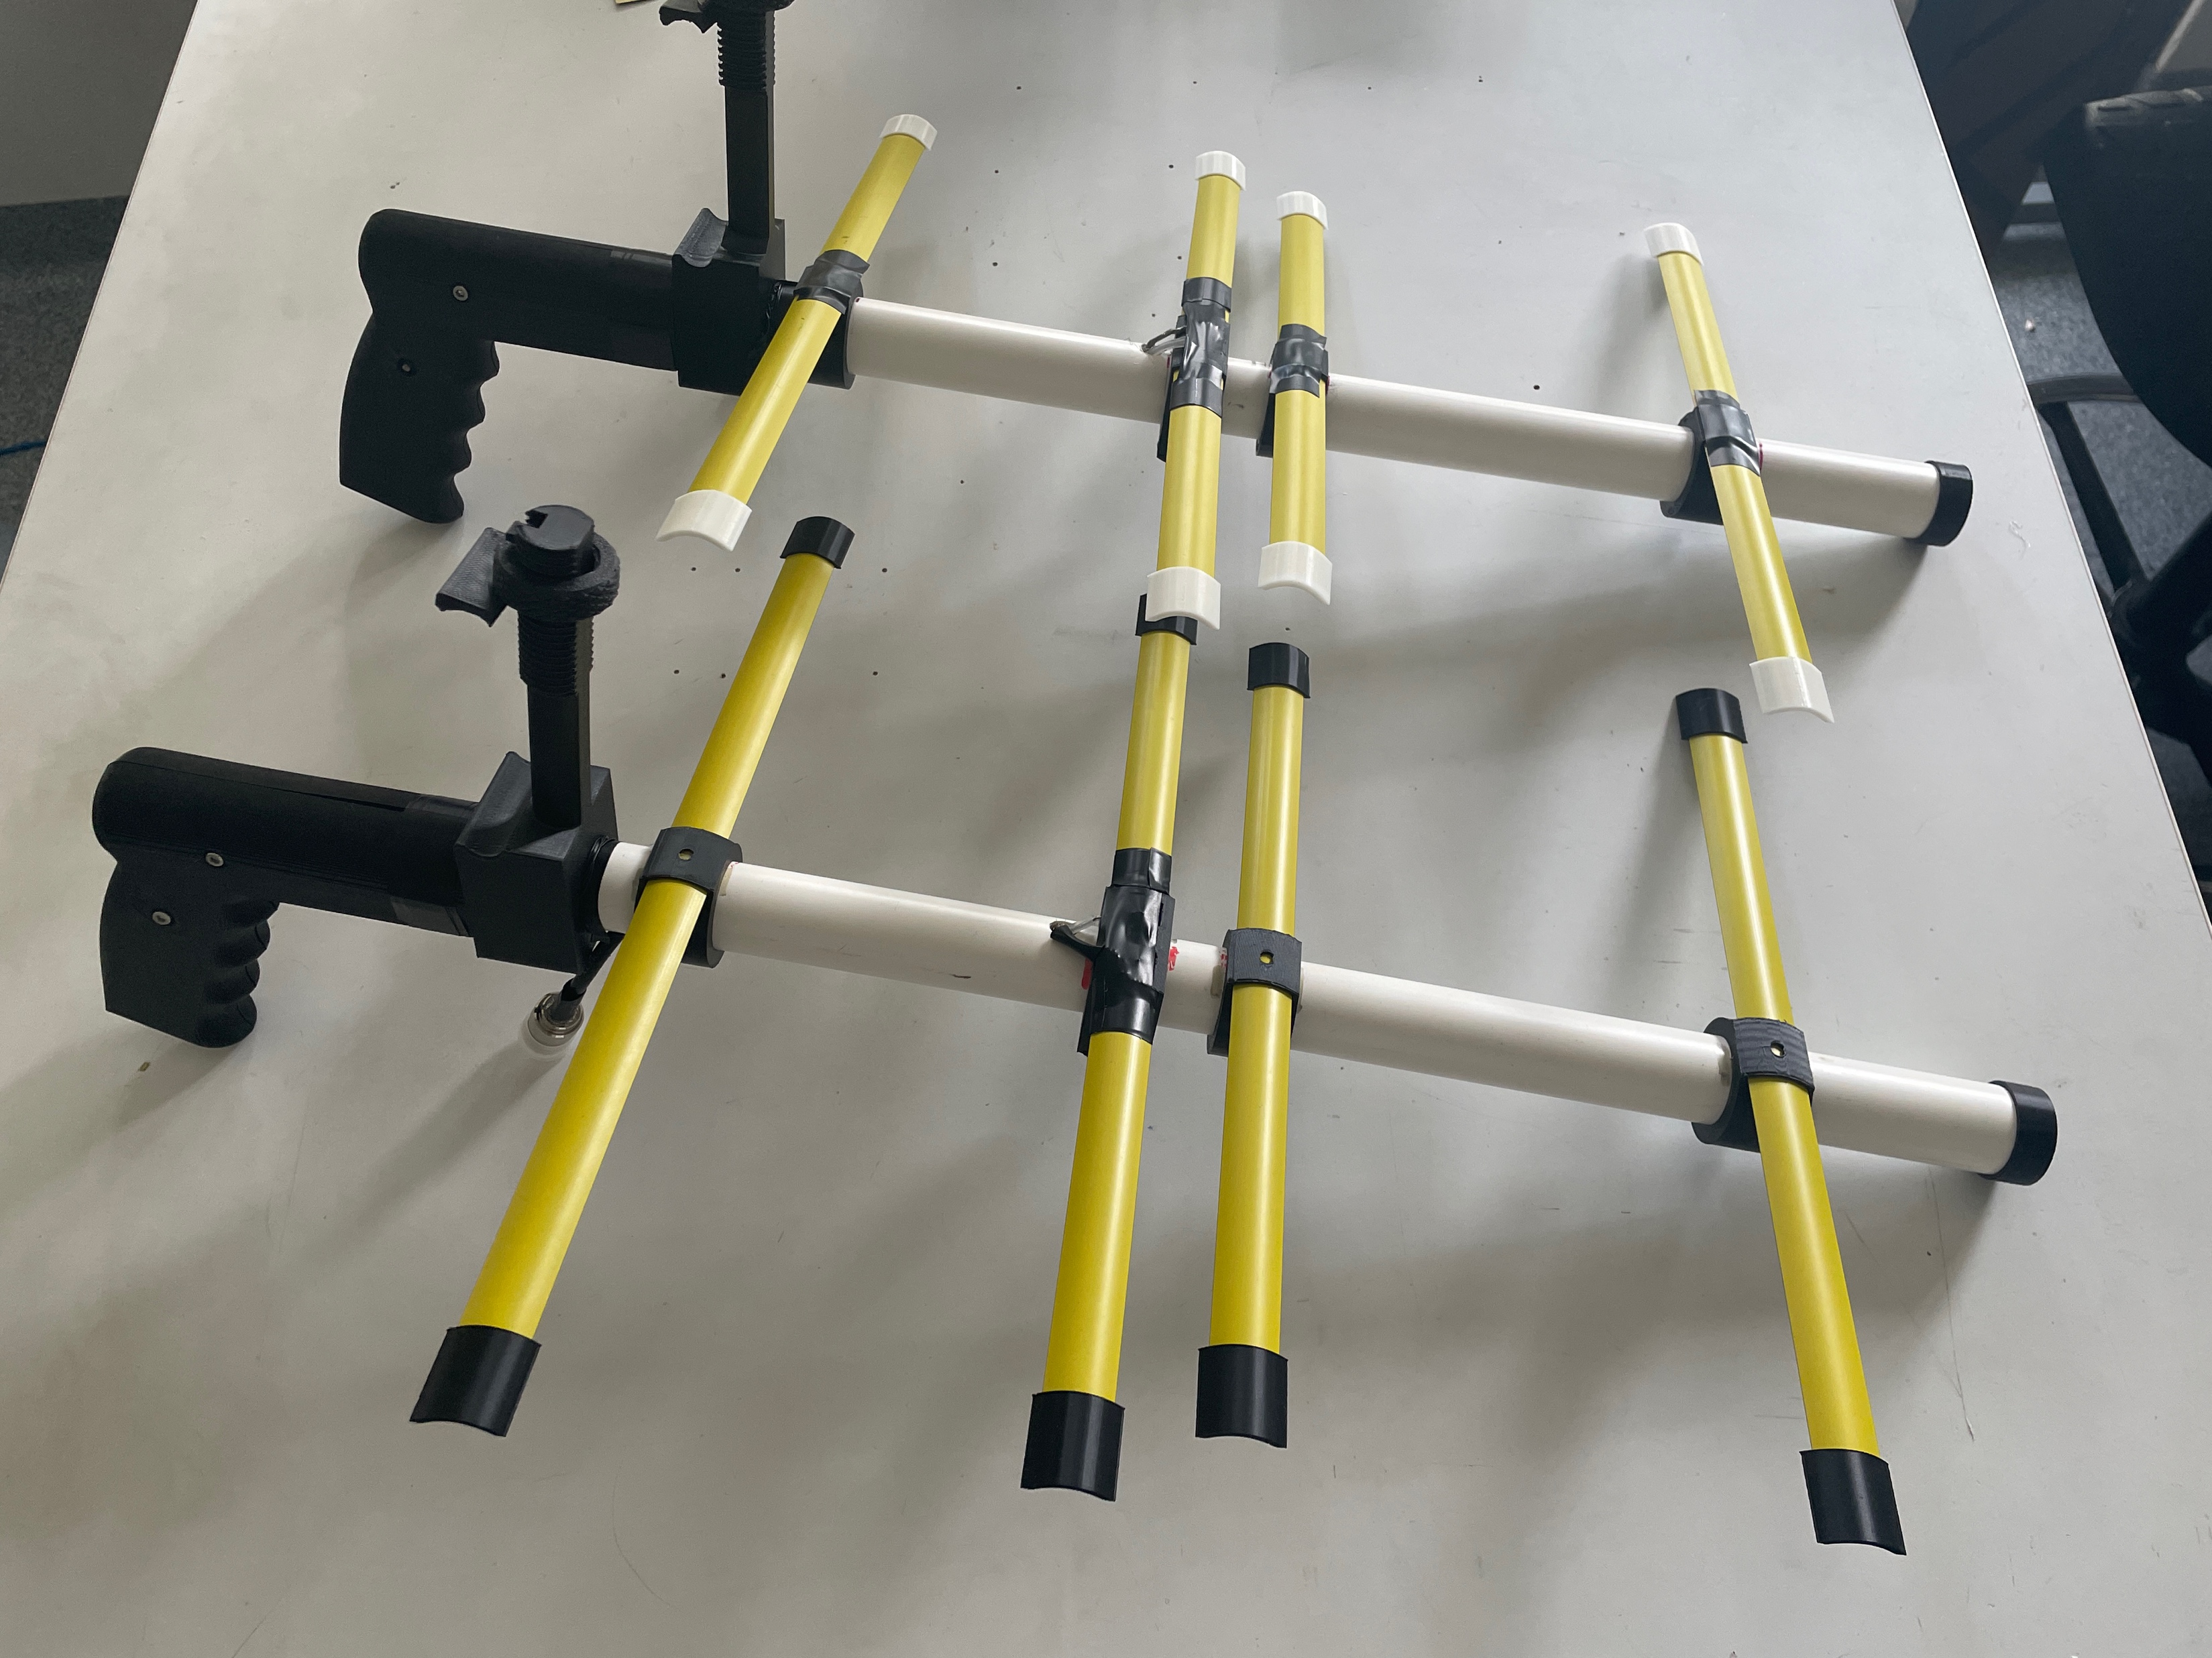
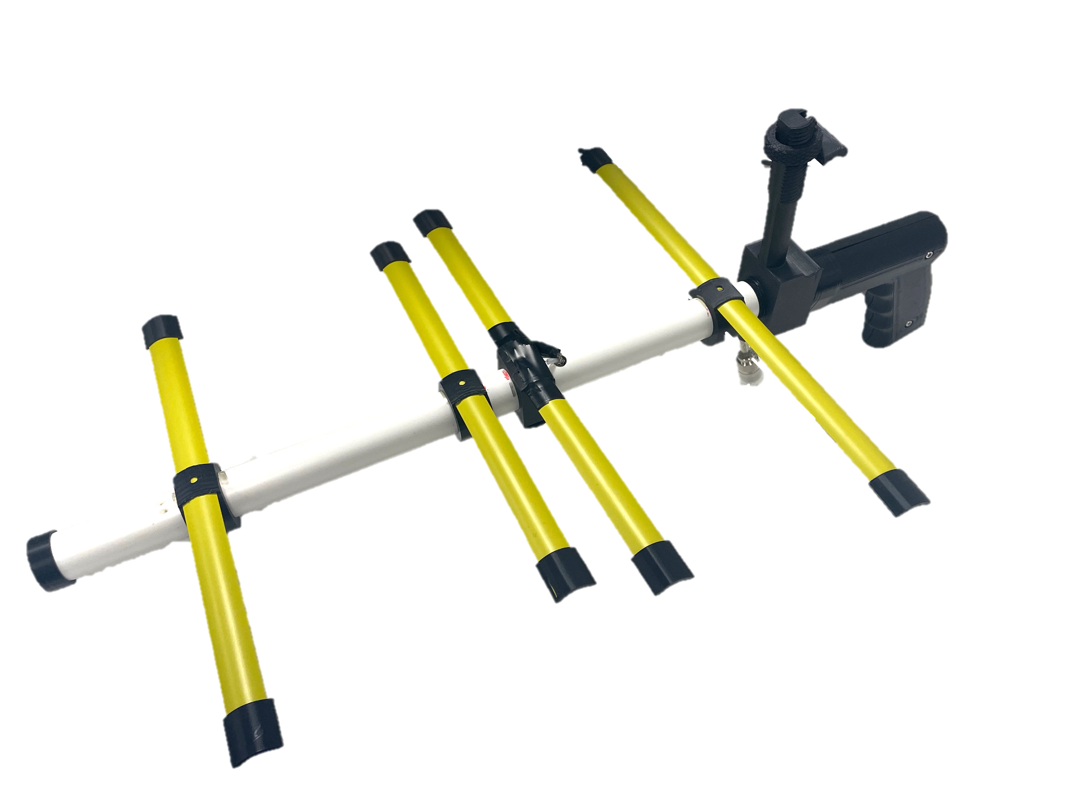
The New Antenna
Designed and Modelled in Ansys HFSS.
The new antenna relies on much more available materials to allow the system to be as accessible and affordable as possible.
Standard coaxial cable and connectors to allow function with the current ground station kit.
Additional ease-of-use features are built into the design to improve accessibility and function.

Slide 10

Manufacturing Process
The antenna itself was designed to be as simple as possible. It consists of a few main steps:
Cutting and preparing the PVC pipe.
Cutting and preparing the coaxial cable.
Inserting the 3D printed brackets.
Cutting and soldering the tape measure
Add any remaining parts and cover the exposed connections.
All these steps have been detailed in a user-friendly instruction manual that another individual could reproduce with no prior experience.

Slide 11
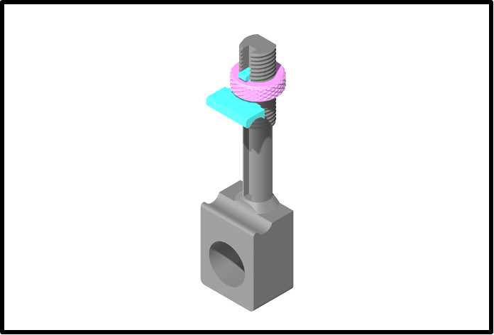
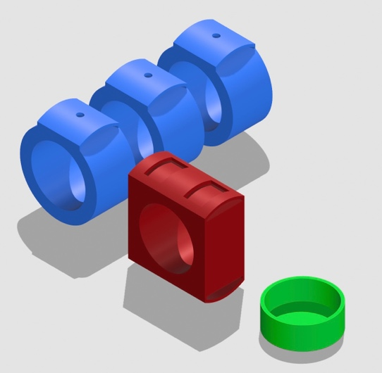
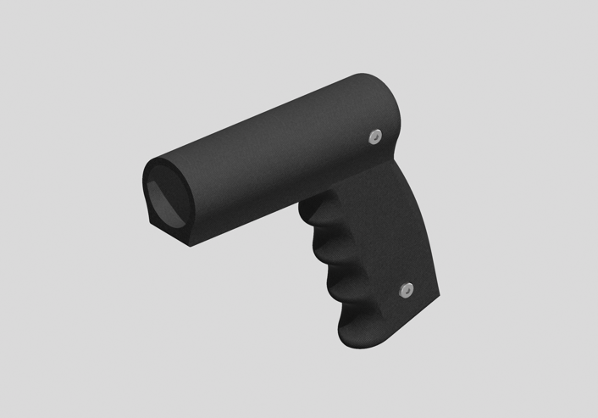
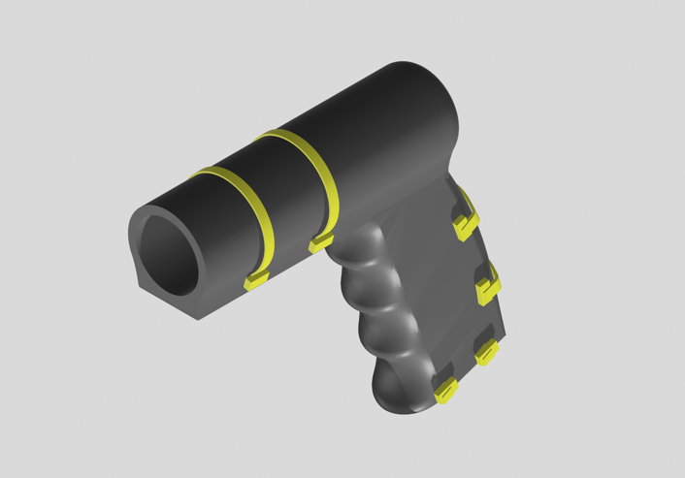
3D Printing
The design revolves heavily around the use of 3D-printed parts.
3D printing has become a mainstream manufacturing process, allowing individuals to quickly and cheaply produce complex geometries.
All major brackets or mounting elements for the antenna were designed around FDM 3D printing. The advantages of which include:
The final model becomes cheap and accessible
Allows custom part geometries.
Parts have the suitable strength necessary for the final antenna.

Slide 12
Overall Cost
$
Designing around affordability, the material choices made, adjusted for a single unit, allow each antenna to have a cost of under $13.00 per unit.
The ability for the antenna to be affordable was crucial to ensure that it was accessible to the greater public without the need for complex tools.
Item Type /Unit | Cost
PVC Pipe | $0.82
Coaxial Cable | $0.50
Measuring Tape | $2.08
Electrical Tape | $0.03
UHF Connector | $7.70
Hardware | $0.06
3D Printables | $1.31
 | $12.50

Slide 13

Testing and Validation
Two sets of tests were run to verify the design.
Modelling and simulation
Real-World testing
Modelling and simulation were achieved utilising Ansys HFSS
Important to optimise and understand the antenna characteristics prior to manufacturing.

Slide 14
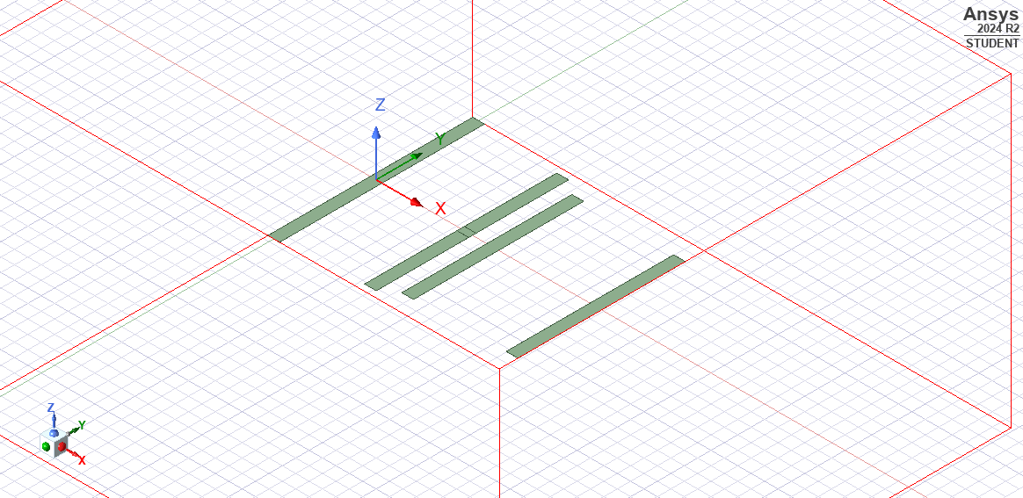
Modelling and Simulation
The parameters were initially designed and simulated over the course of 3 revisions.
The best was chosen to be the basis of the fabricated design.
The following plots showcase the parameters of the designed antenna chosen.

Slide 15
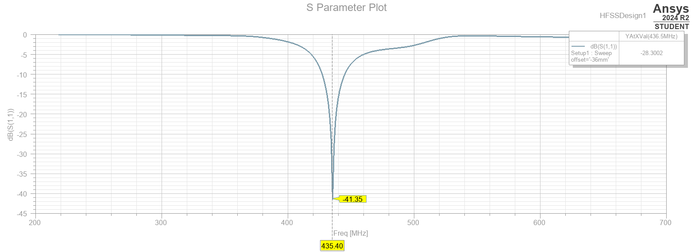
Modelling and Simulation

Slide 16
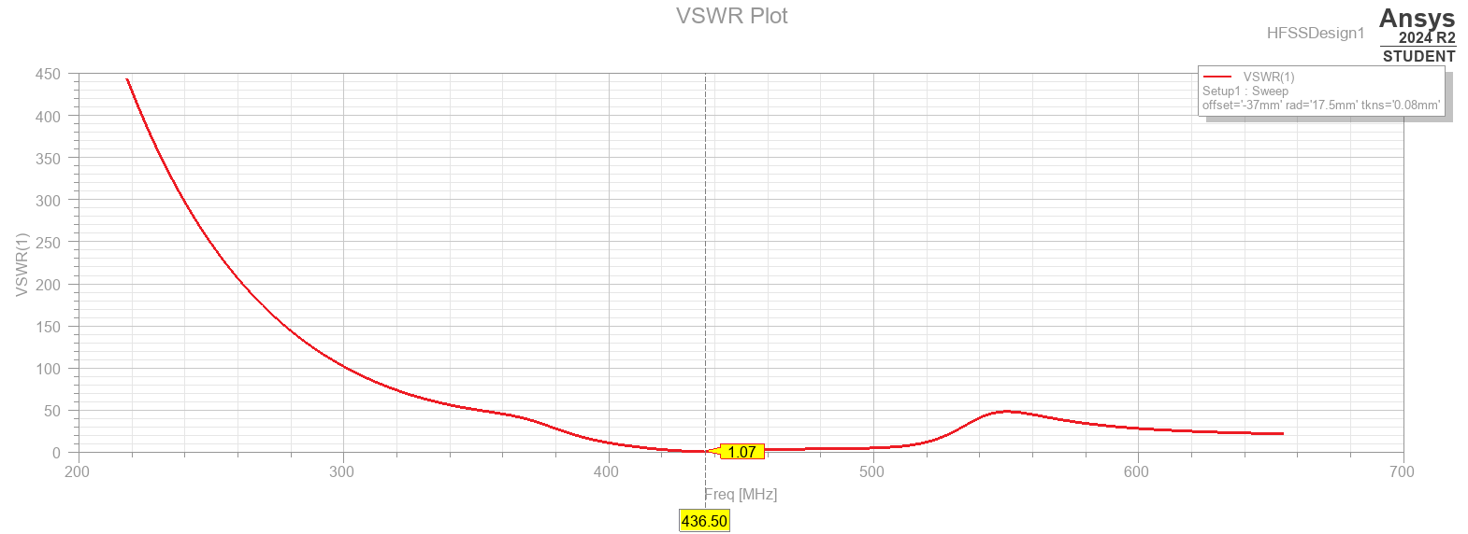
Modelling and Simulation

Slide 17
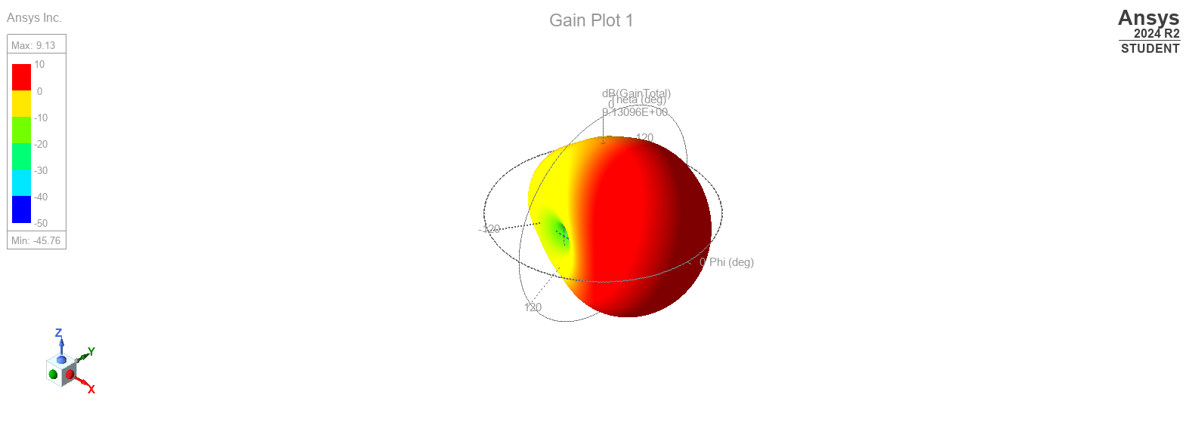
Modelling and Simulation

Slide 18
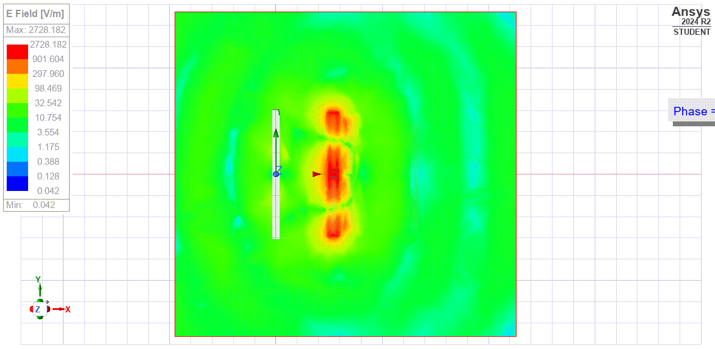
Modelling and Simulation

Slide 19
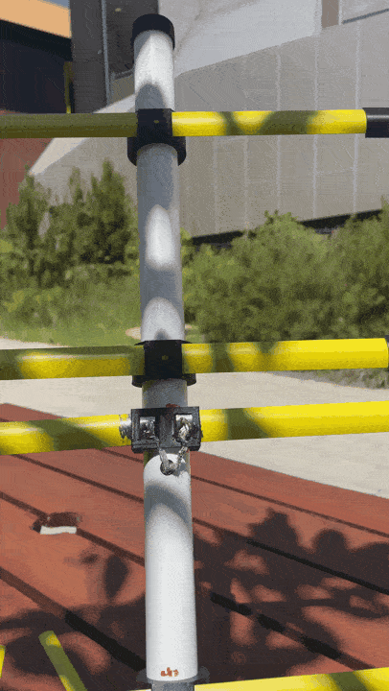
Real-World Tests
The resulting manufactured antenna was then tested in an open area facing skyward as to reduce terrestrial noise.
A NanoVNA was then used to characterise the performance of the antenna, measuring its S11 and SWR characteristics to compare with the simulated values.
Gain could not be measured easily, but given the other characteristics were similar, the gain could be estimated to equal the simulated value.

Slide 20
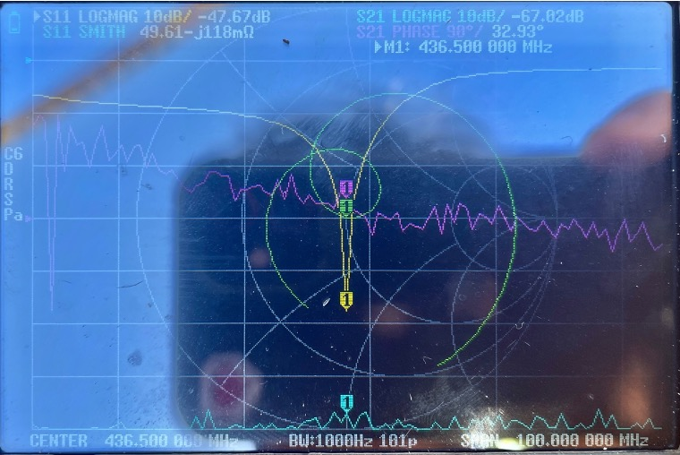
Real-World Tests

Slide 21
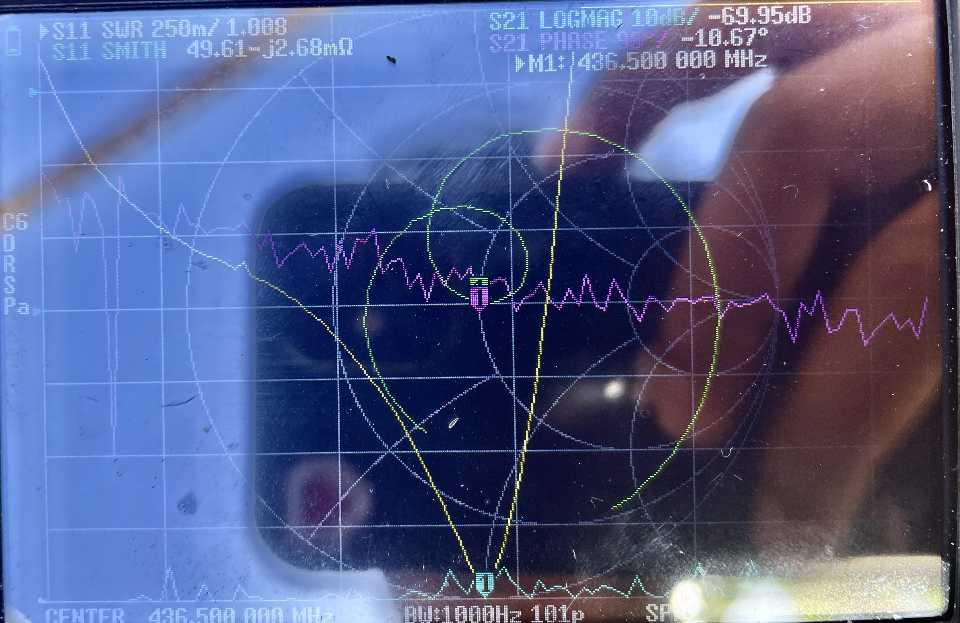
Real-World Tests

Slide 22
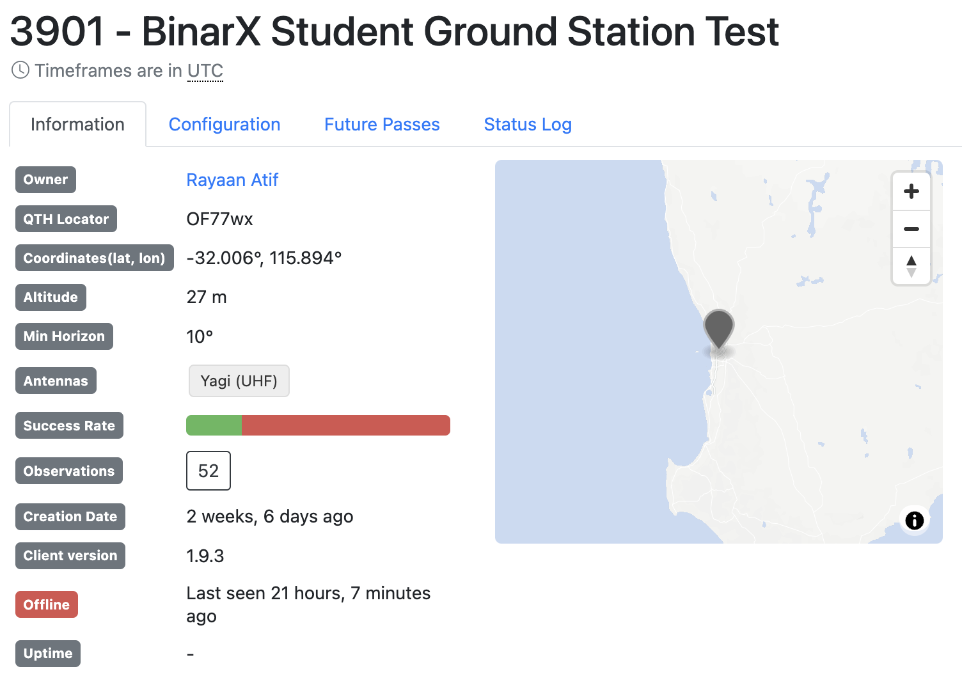
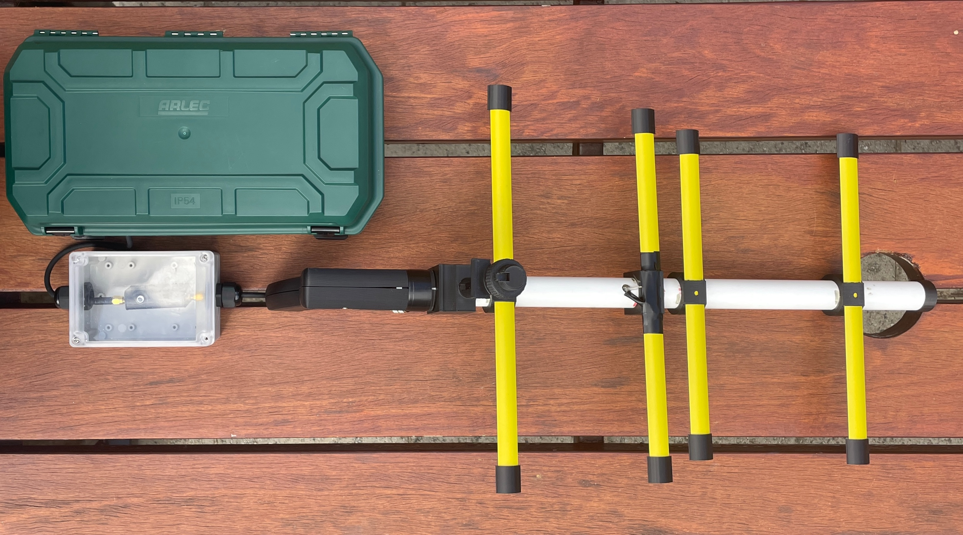
Real-World Tests
Data was acquired using the SatNOGS network to:
Schedule passes.
Collect and demodulate data received.
Passes for satellites KKS-1 and TechSat 1B were scheduled and tracked to receive the following results.
Received and demodulated data indicated great success and validation of the entire system to function together.

Slide 23
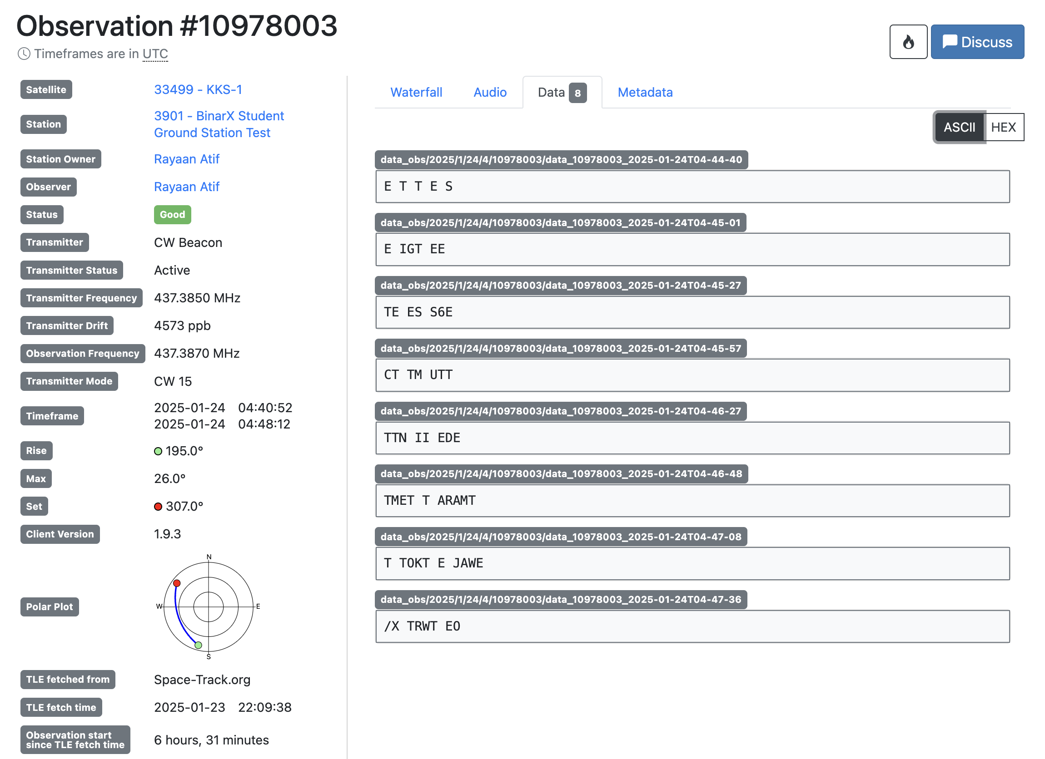
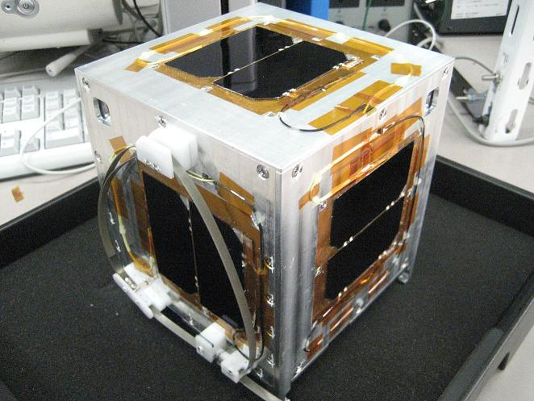
KKS-1
Observation test of KKS-1 on manufactured handheld high-performance antenna operating at 437.3870 MHz.

Slide 24
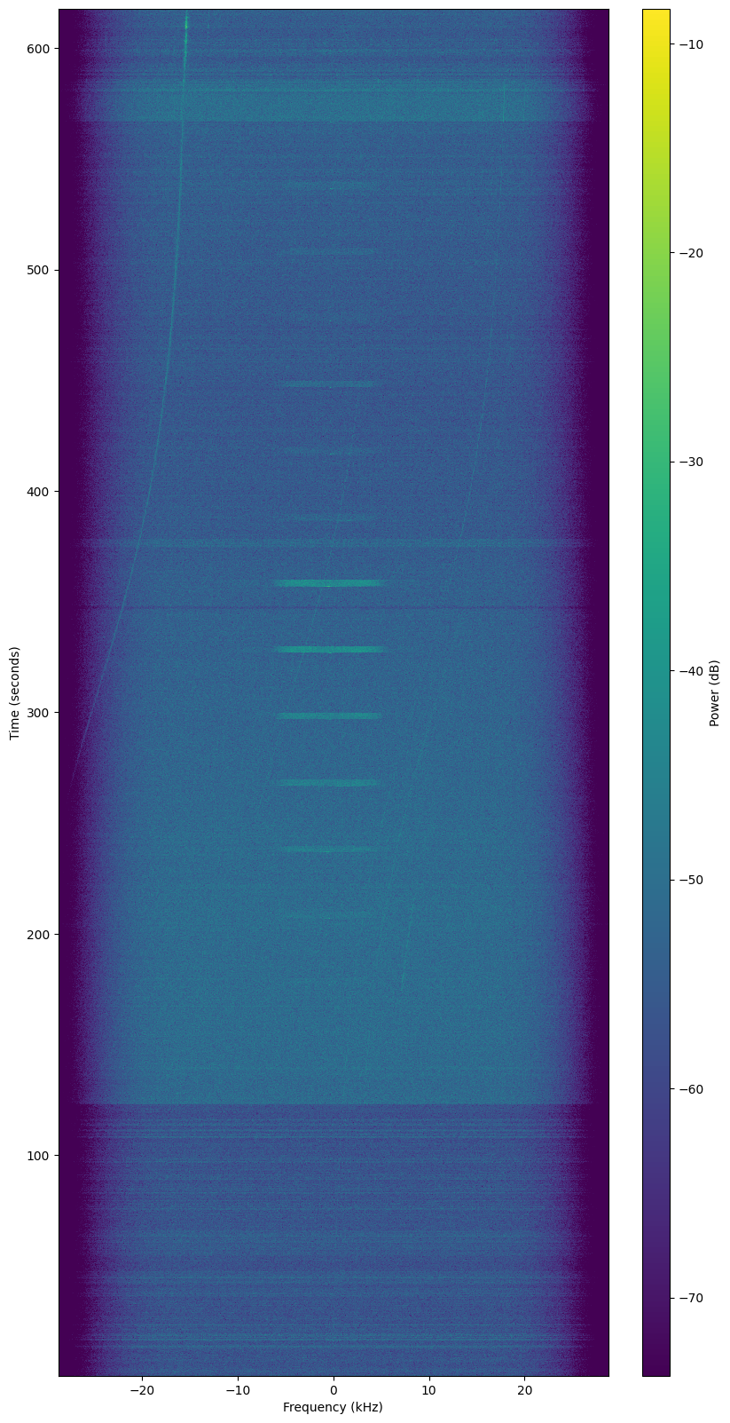
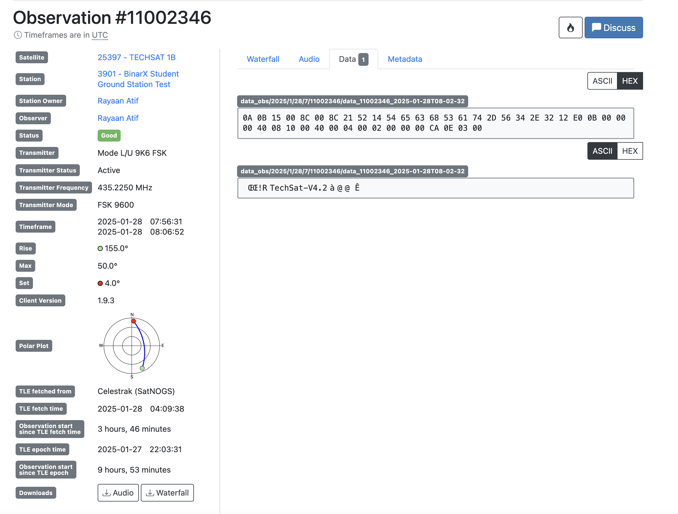
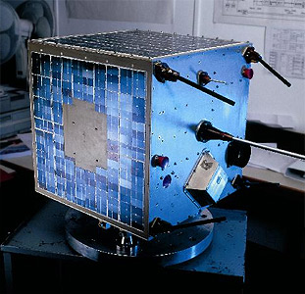
TechSat 1B
Observation of TECHSAT 1B on manufactured handheld high-performance antenna operating at 435.2280 MHz.

Slide 25

How Can it Be More Customisable?
Knowing that the current design works, I decided to create a way for students and educators to create their own antennae for any frequency or parameter change they wished.
This was achieved through the use of a simple web program programmed in HTML, CSS, and Javascript to calculate the lengths and positions of an input number of elements for any given frequency.

Slide 26
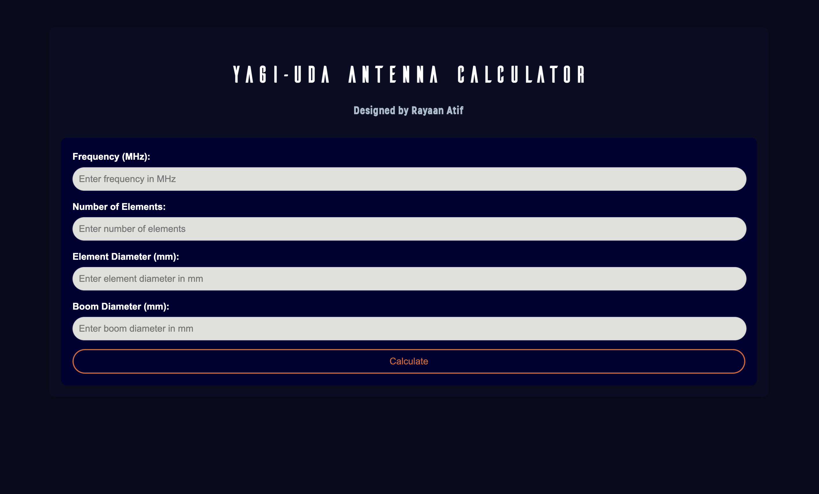
The Calculator

Slide 27
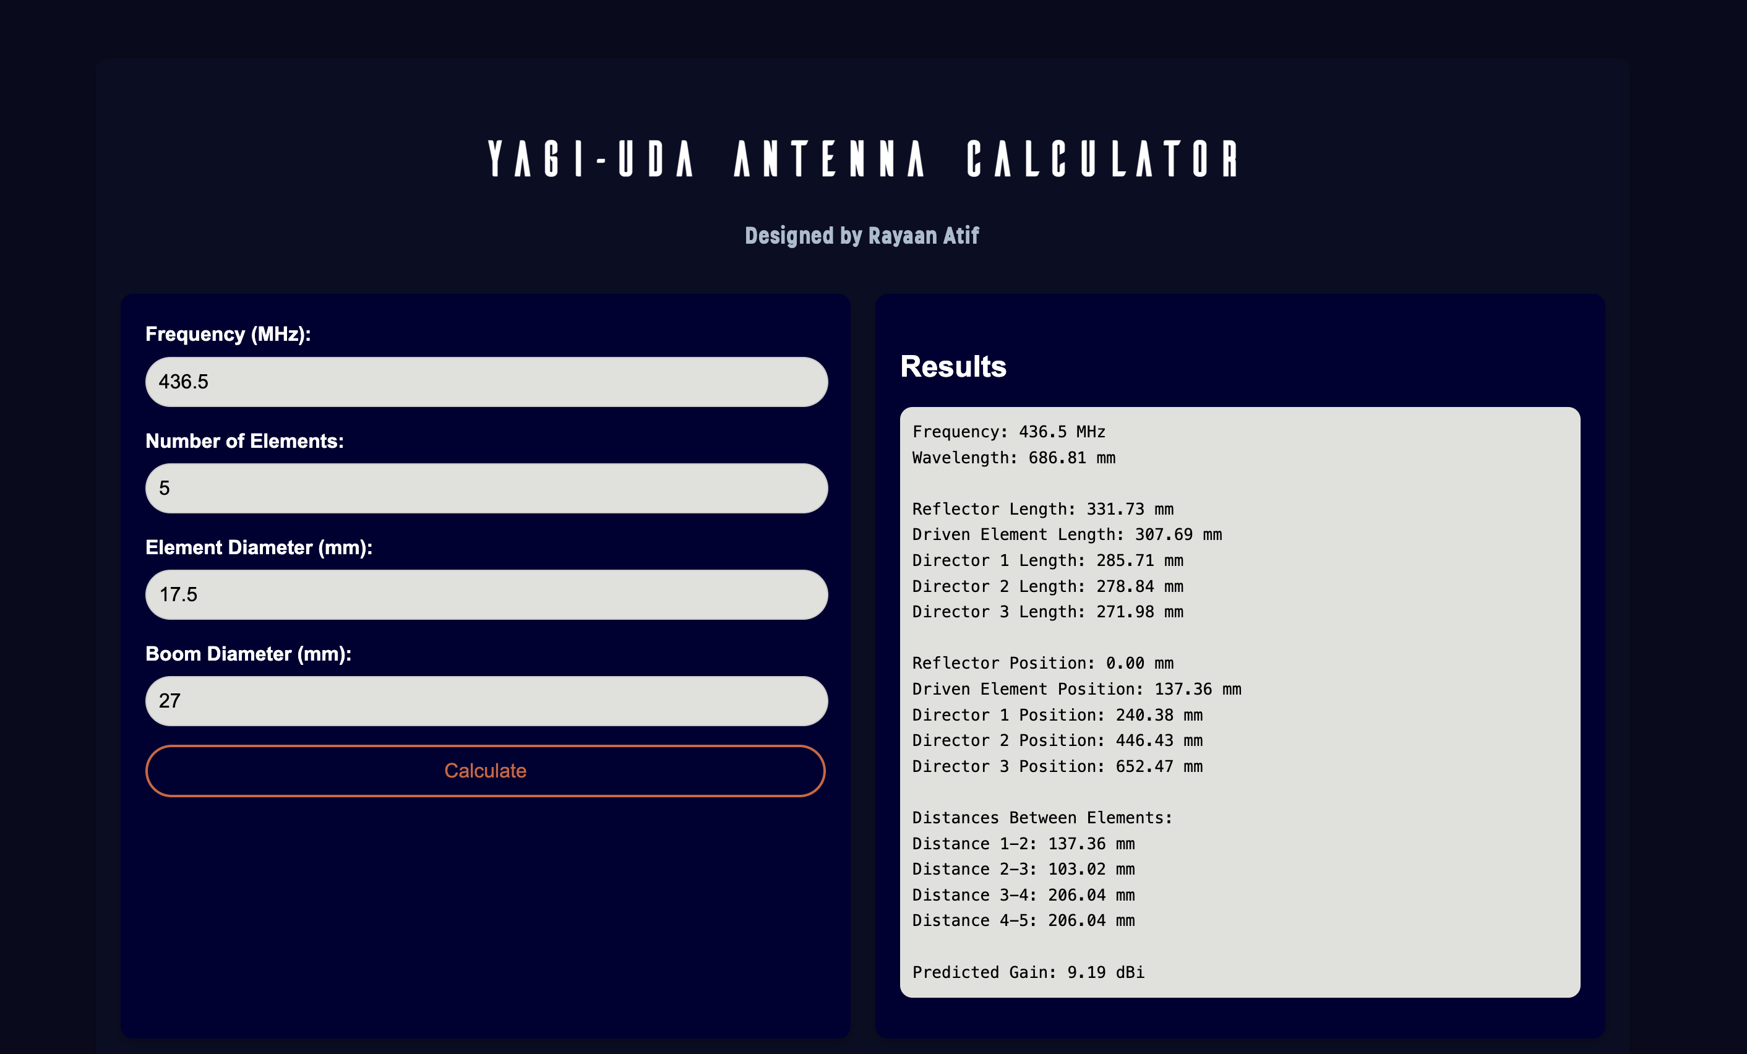
The Calculator

Slide 28
Testing and Validation
Knowing the simulated values were closely tied to the real-world values, only simulations of this stage were carried out due to time restrictions.
Modelling under the same conditions as the previous tests and using only the calculated parameters, tests were run over a range of frequencies.
The results demonstrated antennae with relatively high gain, greater than 9.6dBi for a four element or higher, whilst still being relatively well matched to the required frequency.

Slide 29
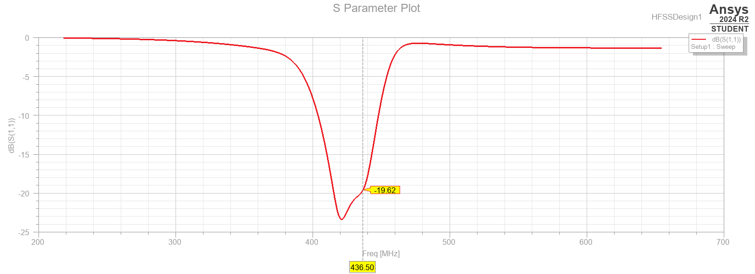
Modelling and Simulation

Slide 30
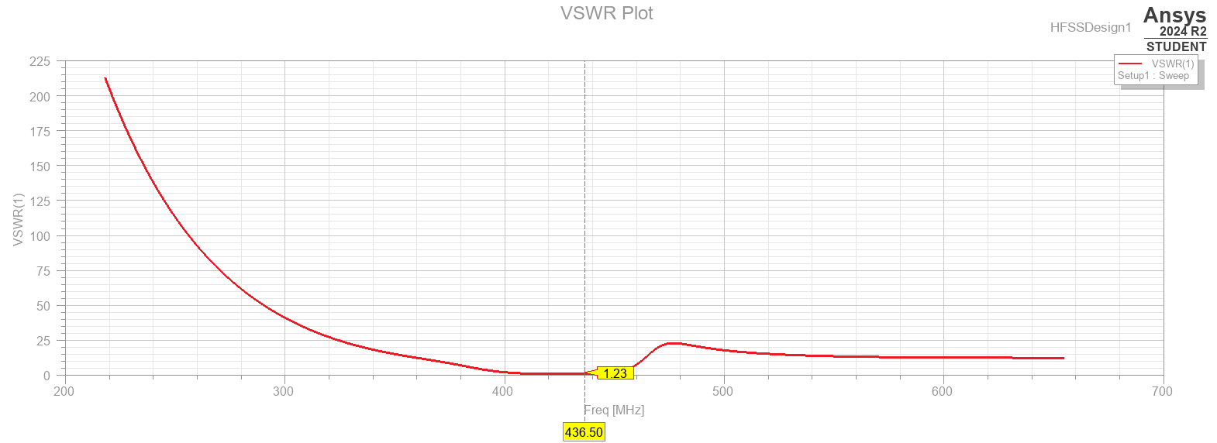
Modelling and Simulation

Slide 31
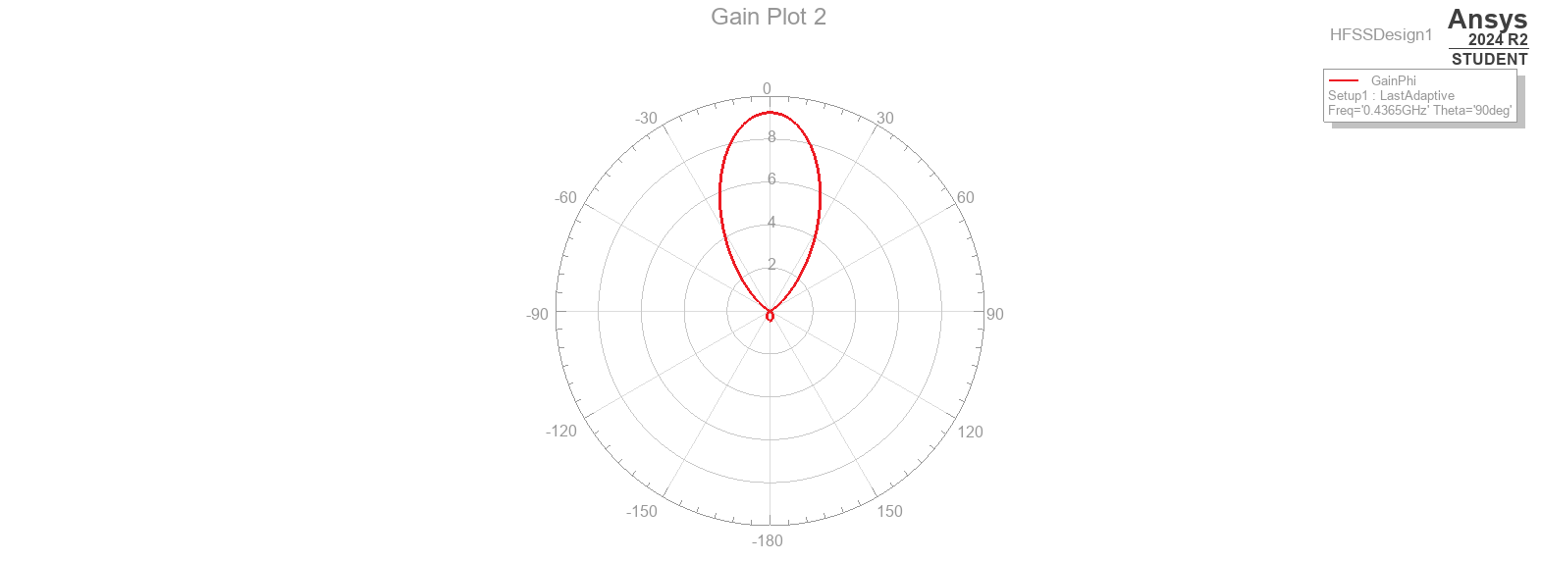
Modelling and Simulation

Slide 32
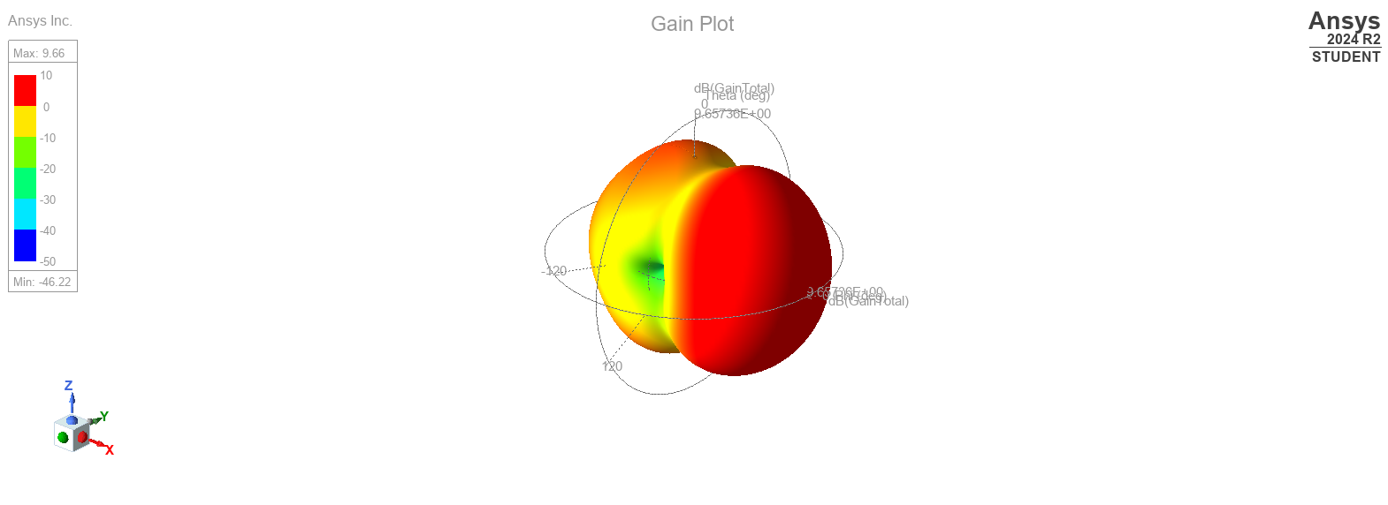
Modelling and Simulation

Slide 33
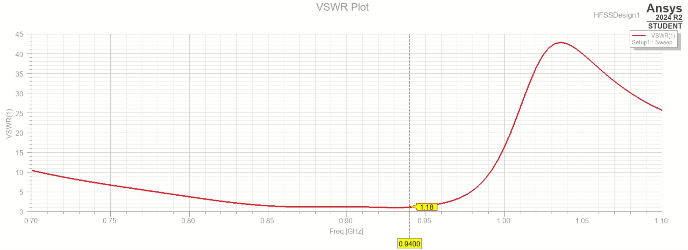
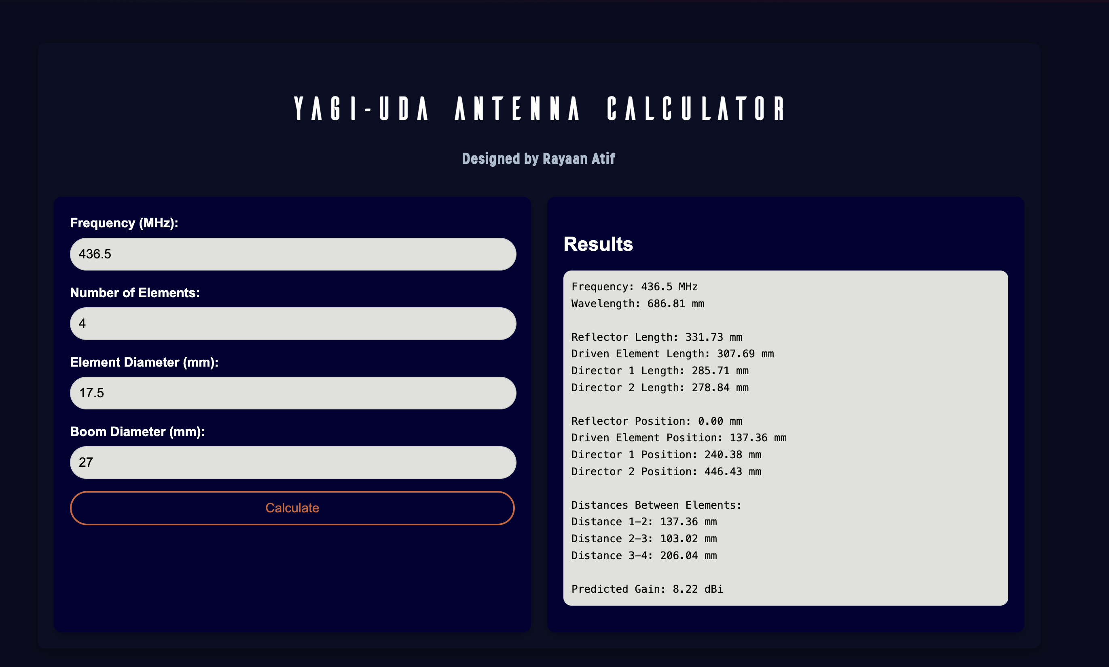
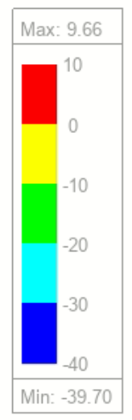
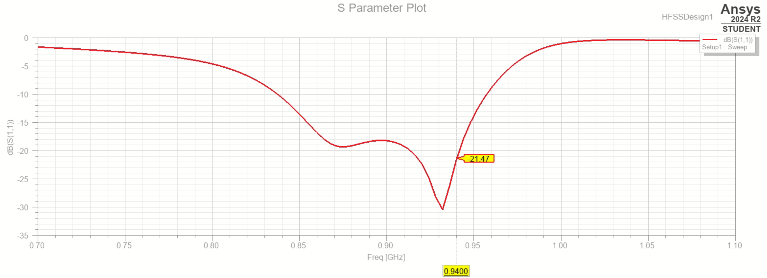
940MHz-4 Element | 9.66 dB

Slide 34
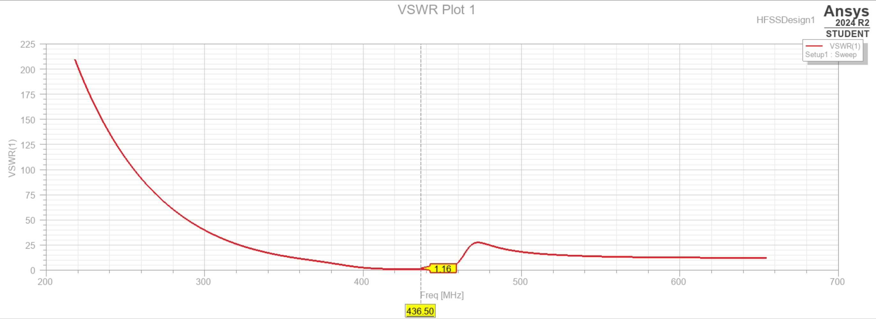
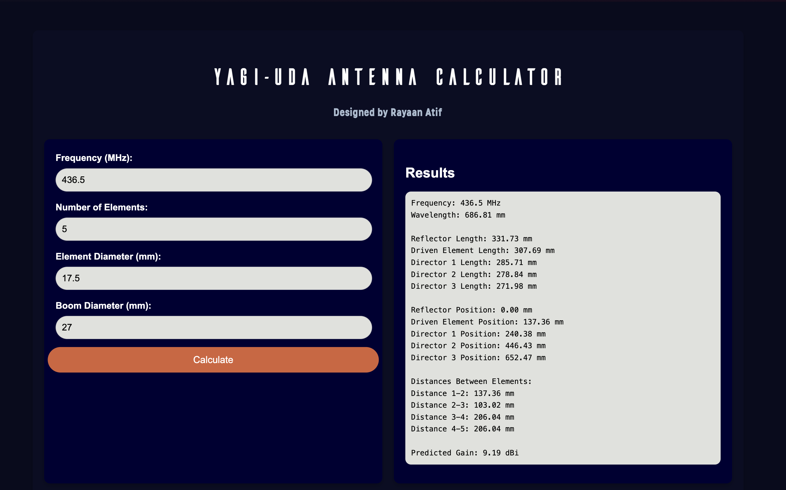
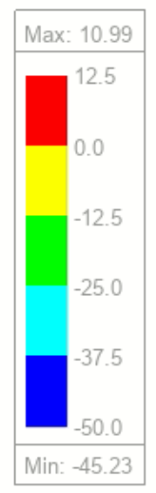
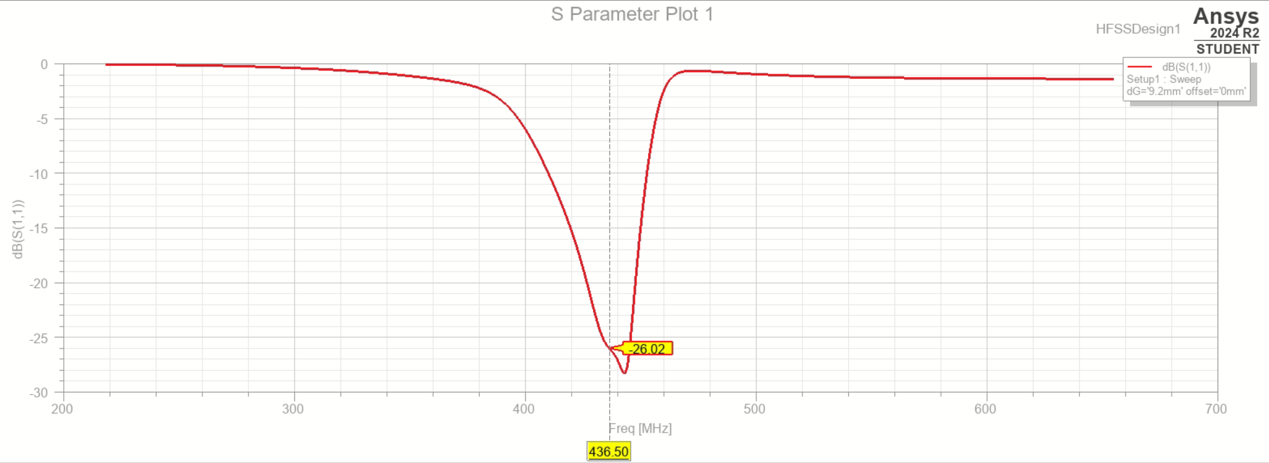
436.5MHz 5-Element | 10.99 dB

Slide 35
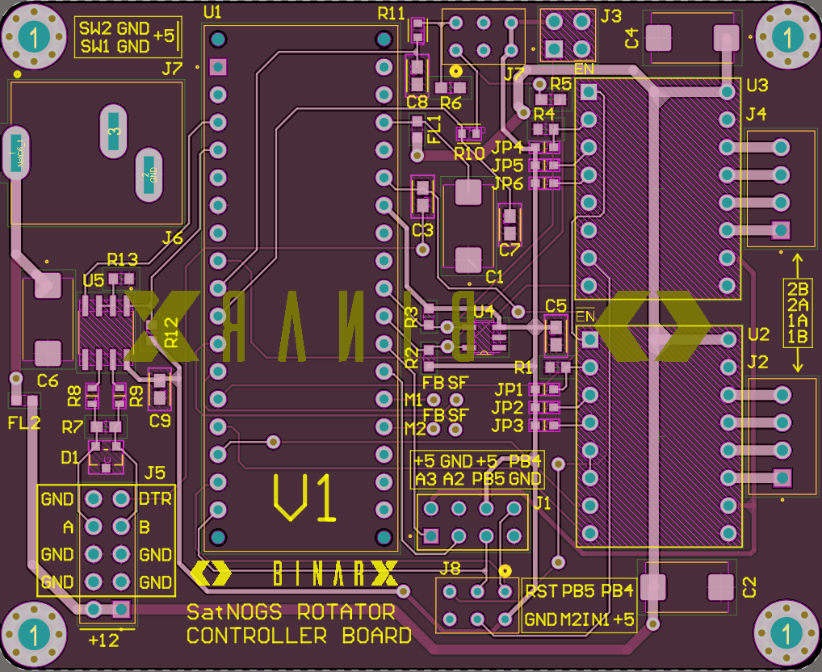
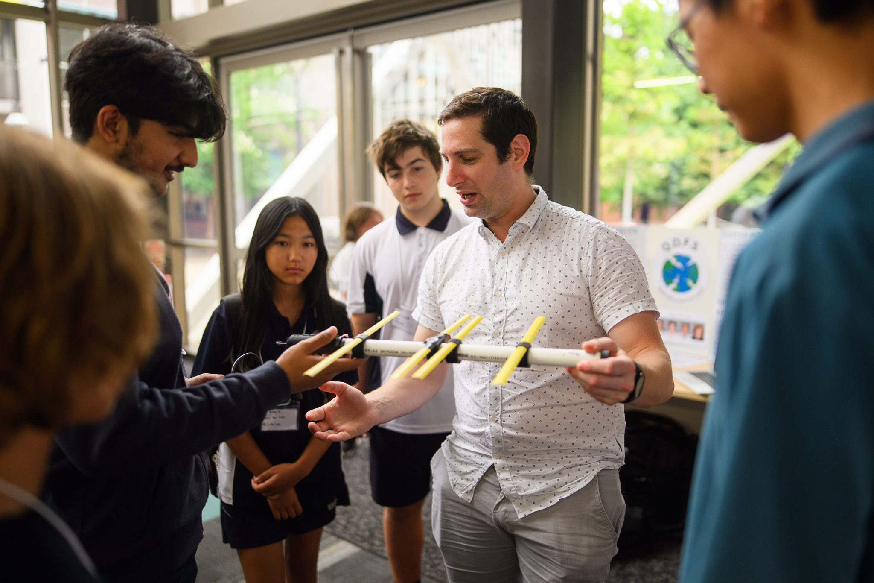
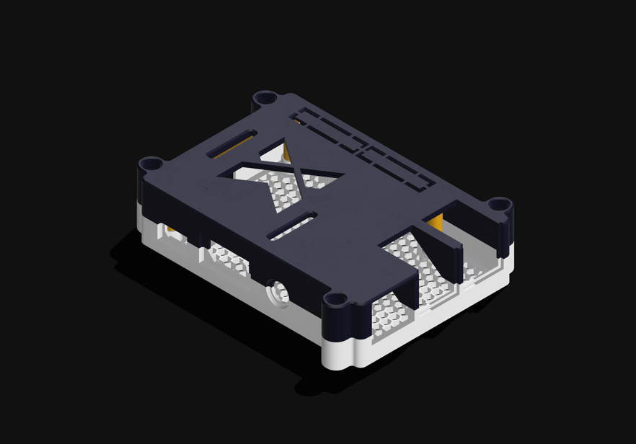
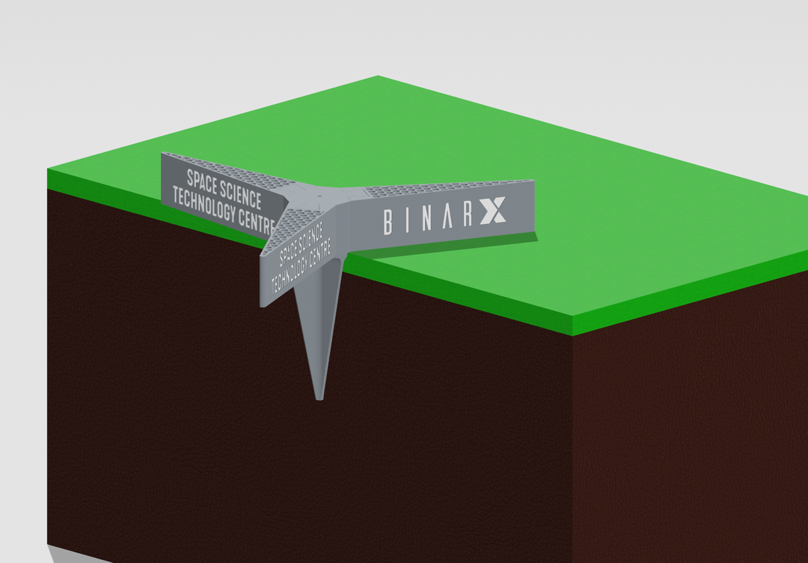
Other Outputs
Multiple other projects were also completed throughout the project.
A custom SatNOGS rotator controller board
A 3D-printed model rocket launch stand
A BinarX themed Raspberry Pi case
Supporting BinarX’s professional development day and the school holiday program.

Slide 36
Future Recommendations
Through the completion of the project, a few recommendations can be made.
Design a method to compensate for 3D printer tolerances.
Create parametric models to allow a broader variety of parts to be used
Alter the guide for the preconfigured SatNOGS image to provide details of a more streamlined installation process.
Create a guide to use the calculator web application and integrate it into a GitHub page.
Create a visual representation of calculated antennae to provide a visual reference.
Organise and create a guide based on the SatNOGS rotator, to include the mechanical assembly required.

Slide 37
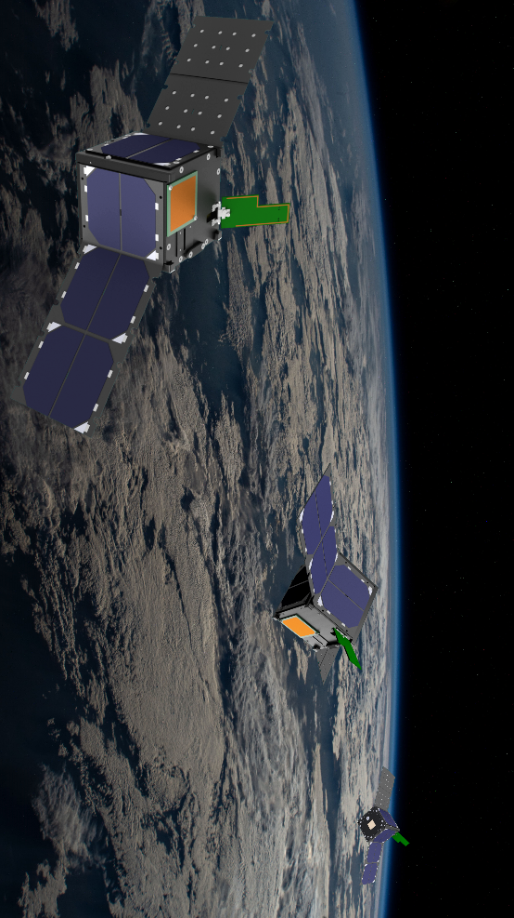

THANKS FOR LISTENING
Email: @curtin.edu.au Website: binarspace.com

